Slide 1

Linear Algebra for Video Game Dev
Presented by Ahmed Al-Kataby, Ayham Al-Akhally and Idris Hajar

Slide 2

Linear Algebra for Video Game Dev
Presented by Ahmed Al-Kataby, Ayham Al-Akhally and Idris
Introduction
Math
Digital Graphics
Video Game Dev

Slide 3

Presented by Ahmed Al-Kataby, Ayham Al-Akhally and Idris
Linear Algebra for Video Game Dev
Introduction
Math
Digital Graphics
Video Game Dev

Slide 4
Linear Algebra for Video Game Dev
Introduction
Math
Digital Graphics
Video Game Dev
What Is Video Game?
Video Games vs Movies and Pictures

Slide 5
Linear Algebra for Video Game Dev
Introduction
What Is Video Game?
Math
Digital Graphics
Video Game Dev
Video Games vs Movies and Pictures
It is a computer program that contains a collection of visual and non-visual components to make an imagined world. Players can interact with these components to affect this world by using a controller. There are many types of video games, such as horror games, surviving games and RPG games.

Slide 6

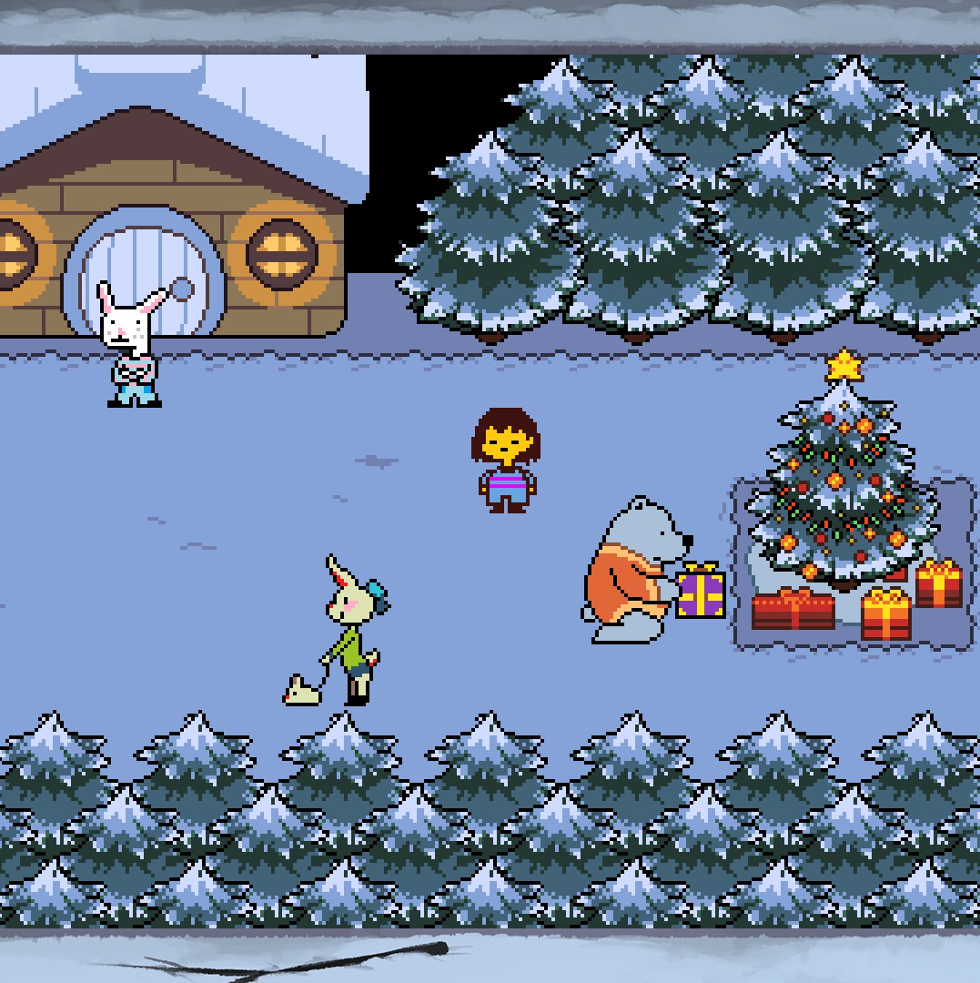

Linear Algebra for Video Game Dev
Introduction
What Is Video Game?
Math
Digital Graphics
Video Game Dev
Video Games vs Movies and Pictures
It is a computer program that contains a collection of visual and non-visual components to make an imagined world. Players can interact with these components to affect this world by using a controller. There are many types of video games, such as horror games, surviving games and RPG games.

Slide 7


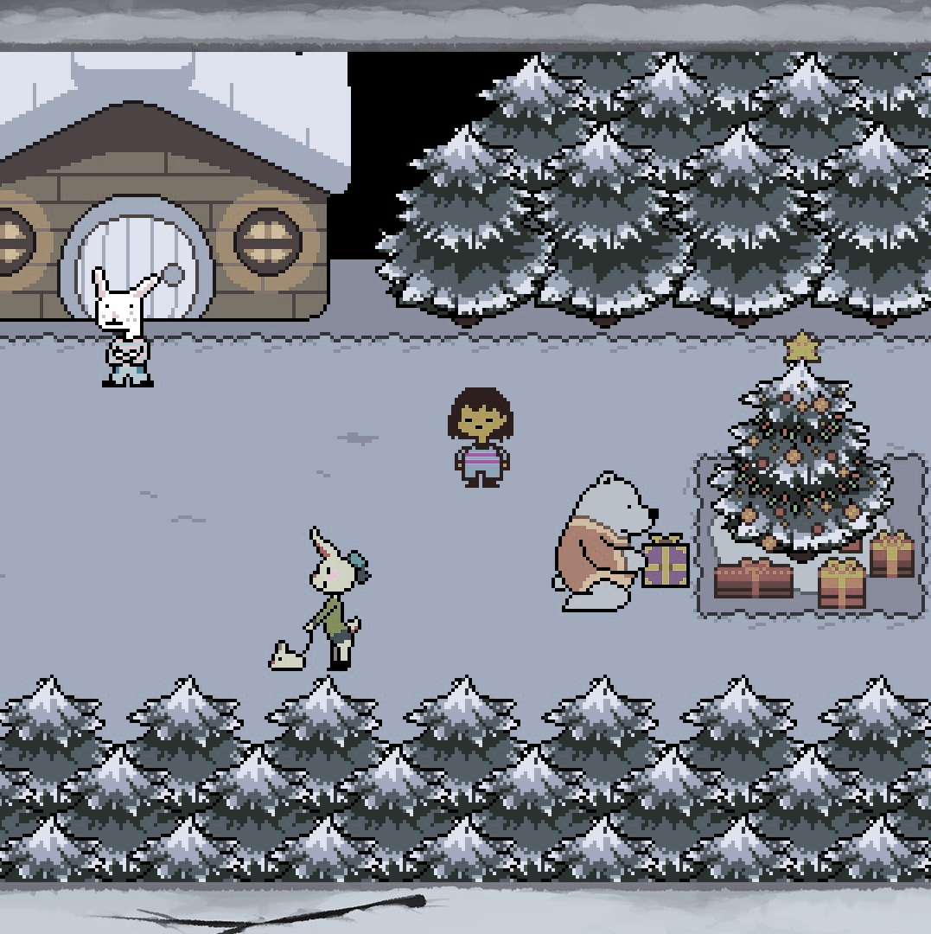
Linear Algebra for Video Game Dev
Introduction
Video Games vs Movies and Pictures
Math
Digital Graphics
Video Game Dev
What Is Video Game?
It is a computer program that contains a collection of visual and non-visual components to make an imagined world. Players can interact with these components to affect this world by using a controller. There are many types of video games, such as horror games, surviving games and RPG games.

Slide 8
Linear Algebra for Video Game Dev
Introduction
Video Games vs Movies and Pictures
Math
Digital Graphics
Video Game Dev
What Is Video Game?
The difference between video games and movies is that movies do not interact with who is watching them. However, video games are interactive. Also, movies rendered once while video games rendered each frames by seconds.

Slide 9
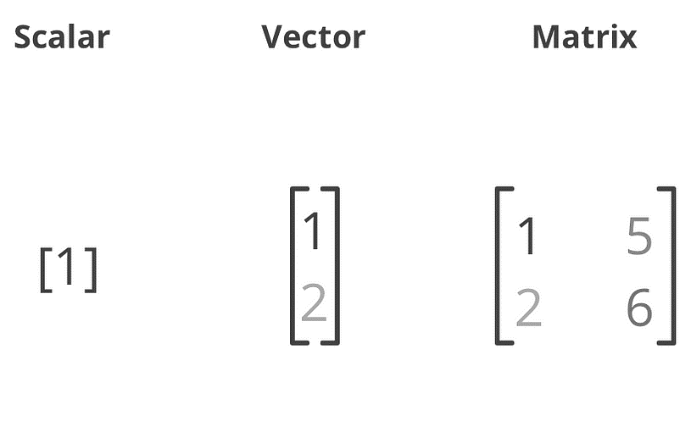
Linear Algebra for Video Game Dev
Introduction
Math
Digital Graphics
Video Game Dev
Video Games vs Movies and Pictures
What Is Video Game?
Matrix
Vector
The difference between video games and movies is that movies do not interact with who is watching them. However, video games are interactive. Also, movies rendered once while video games rendered each frames by seconds.

Slide 10
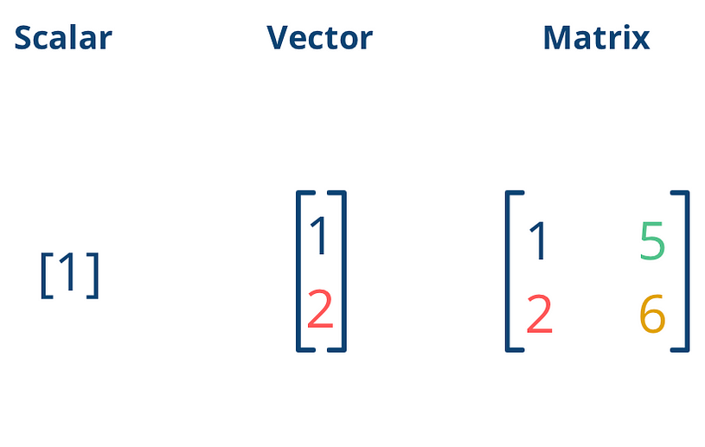
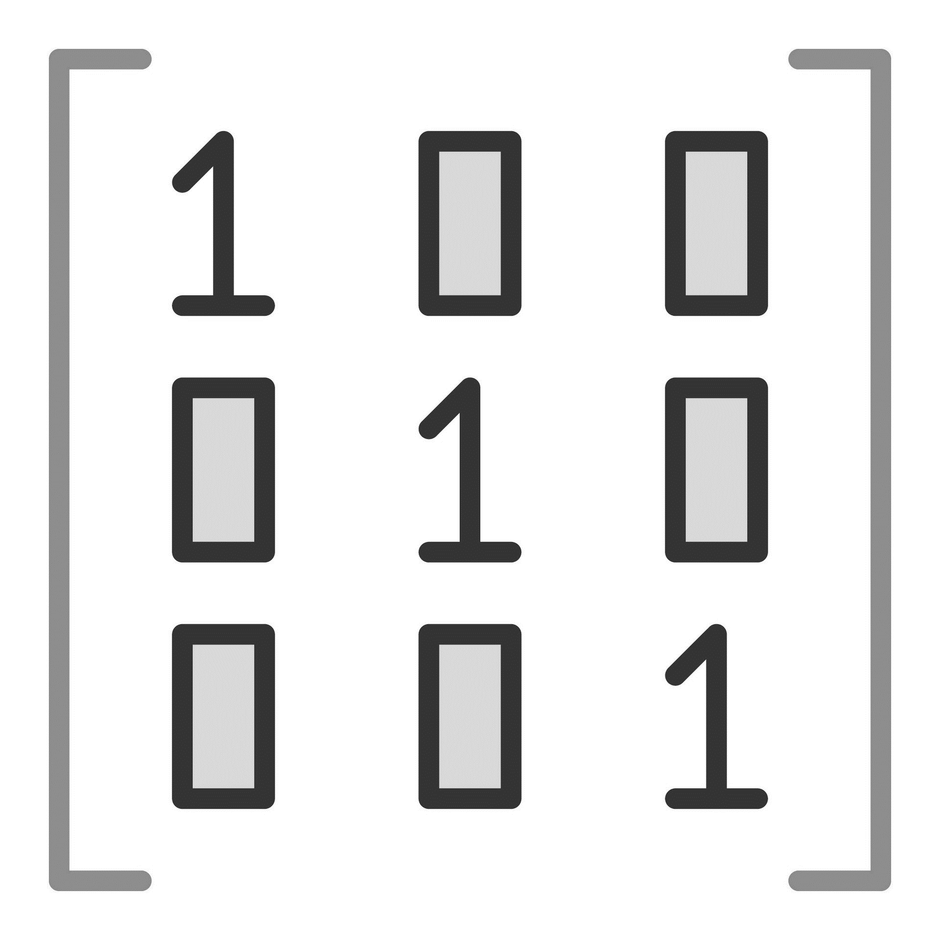
Linear Algebra for Video Game Dev
Math
Introduction
Matrix
Vector
Digital Graphics
Video Game Dev

Slide 11

Linear Algebra for Video Game Dev
Math
Introduction
Matrix
Digital Graphics
Video Game Dev
Vector
Explain previously ☺

Slide 12
Linear Algebra for Video Game Dev
Math
Introduction
Vector
Digital Graphics
Video Game Dev
Matrix
What Is Vector?
Add, Subtract and Scale Vectors
Vector Length
Normalized Vector
Explain previously ☺

Slide 13
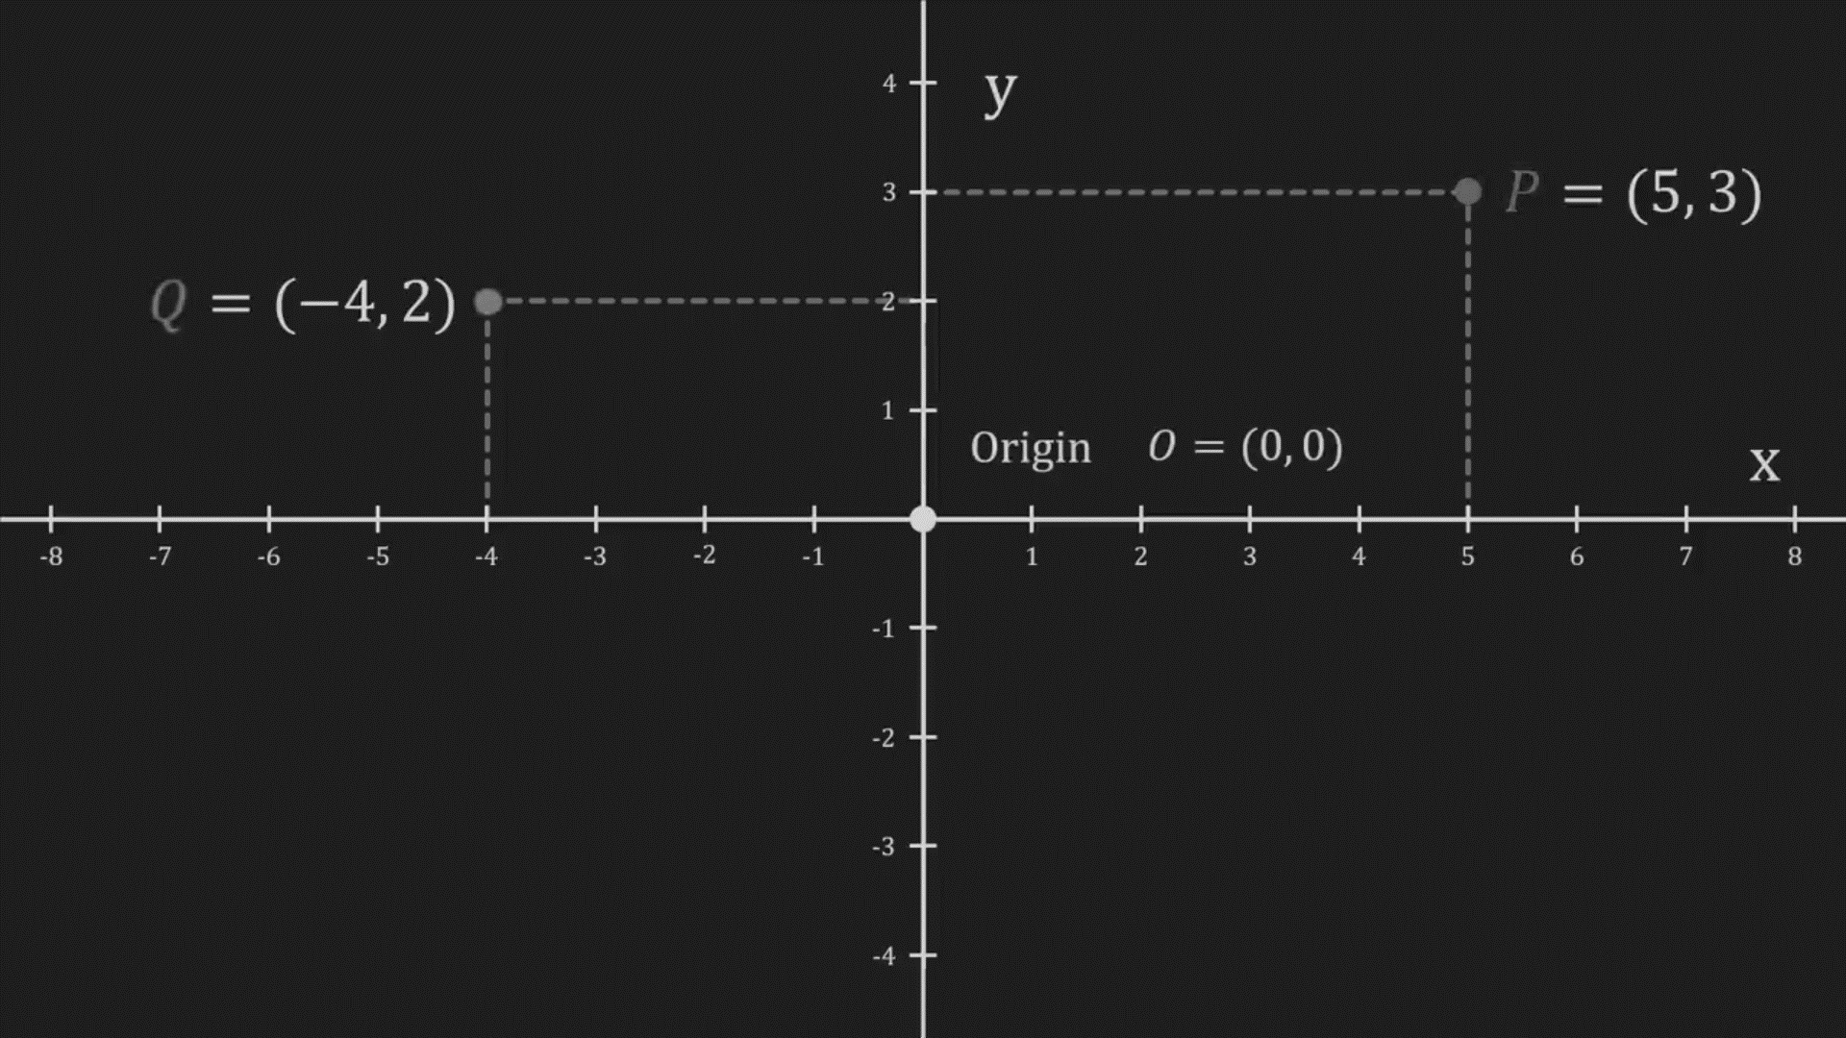
Linear Algebra for Video Game Dev
Vector
Math
Introduction
What Is Vector?
Digital Graphics
Video Game Dev
Add, Subtract and Scale Vectors
Vector Length
Normalized Vector
Matrix
It is an ordered list of numbers, considered a point in the coordinate system without a position. Each vector has a length and a direction. There are many types of vectors, 2-dimensional and 3-dimensional are the common types.

Slide 14
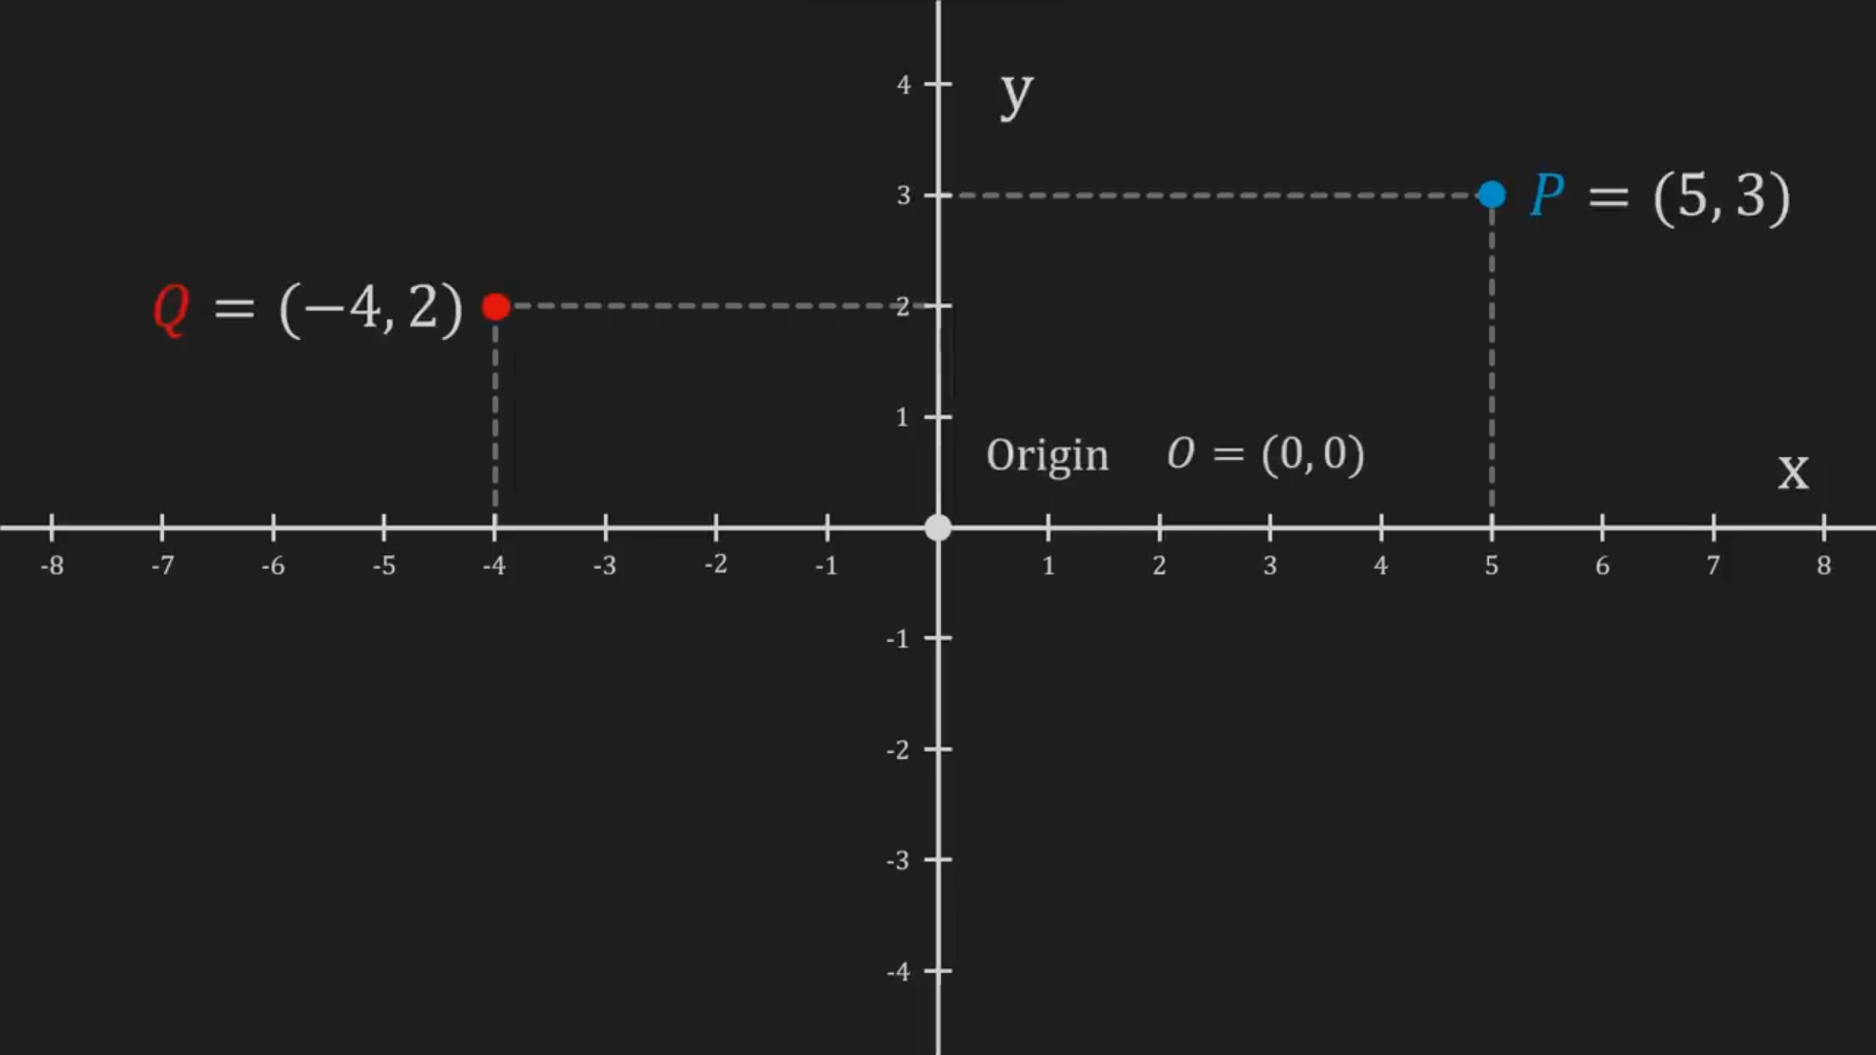
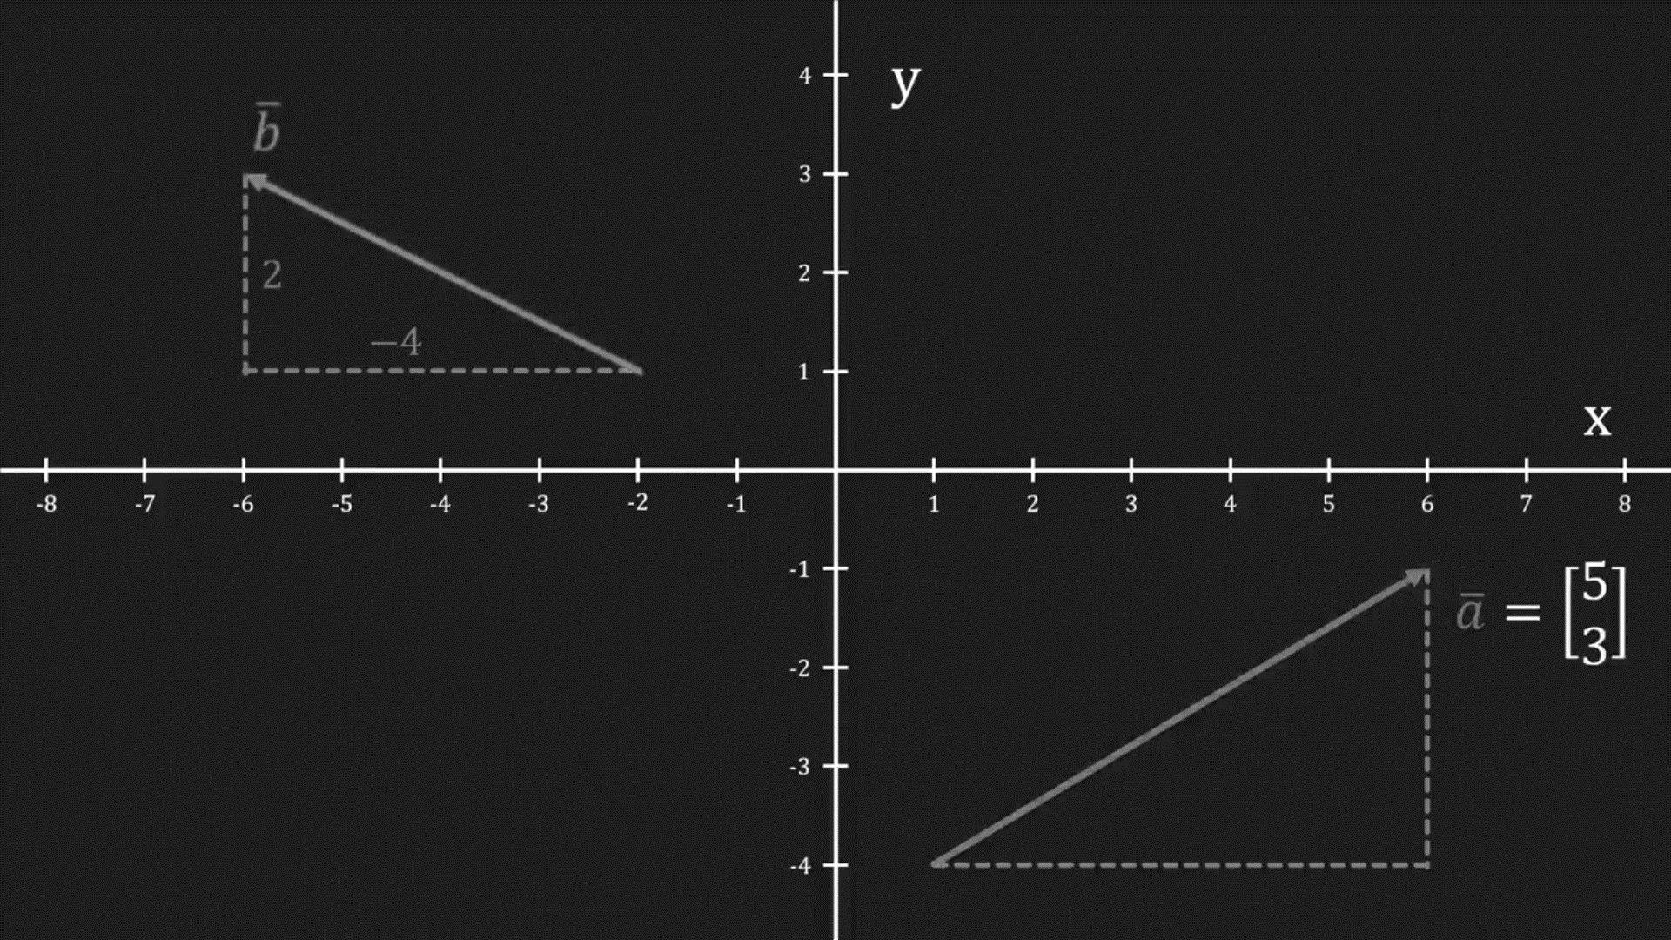
Linear Algebra for Video Game Dev
Vector
Math
Introduction
What Is Vector?
Digital Graphics
Video Game Dev
Add, Subtract and Scale Vectors
Vector Length
Normalized Vector
It is an ordered list of numbers, considered a point in the coordinate system without a position. Each vector has a length and a direction. There are many types of vectors, 2-dimensional and 3-dimensional are the common types.

Slide 15
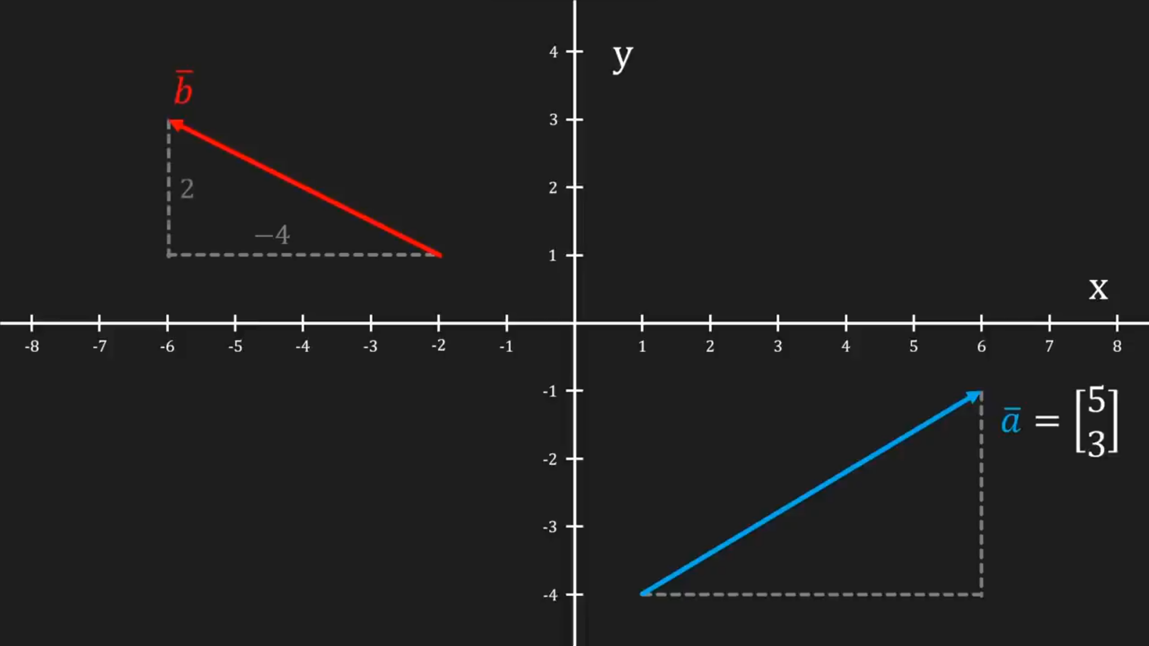
Linear Algebra for Video Game Dev
Vector
Math
Introduction
What Is Vector?
Digital Graphics
Video Game Dev
Add, Subtract and Scale Vectors
Vector Length
Normalized Vector
It is an ordered list of numbers, considered a point in the coordinate system without a position. Each vector has a length and a direction. There are many types of vectors, 2-dimensional and 3-dimensional are the common types.

Slide 16
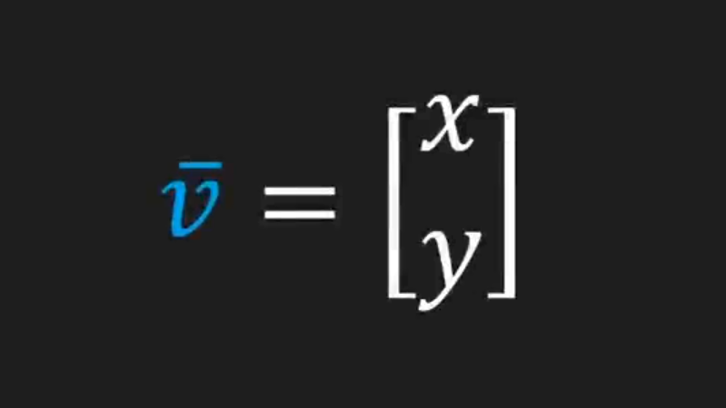
Linear Algebra for Video Game Dev
Vector
Math
Introduction
What Is Vector?
Digital Graphics
Video Game Dev
Add, Subtract and Scale Vectors
Vector Length
Normalized Vector
It is an ordered list of numbers, considered a point in the coordinate system without a position. Each vector has a length and a direction. There are many types of vectors, 2-dimensional and 3-dimensional are the common types.
2D Vector

Slide 17
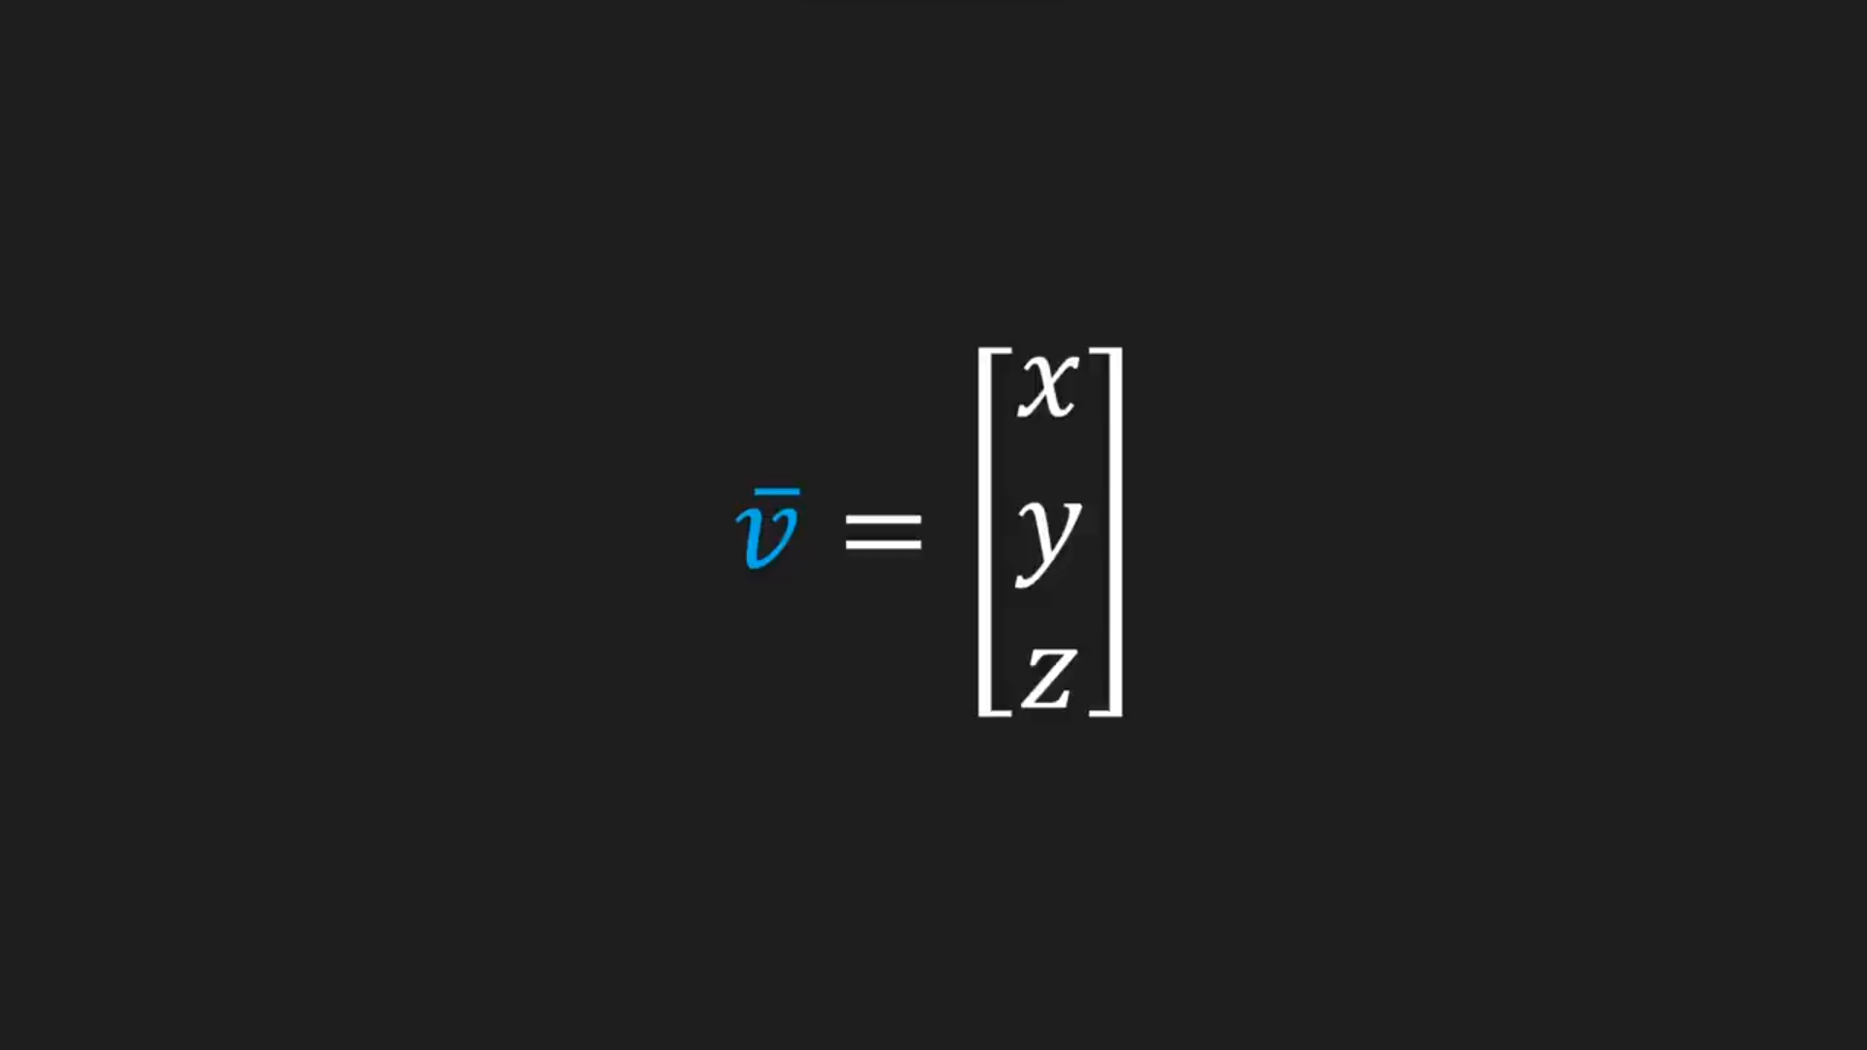
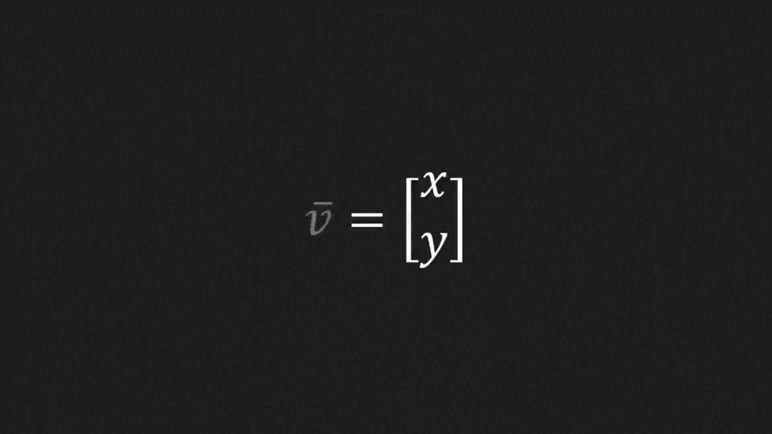
Linear Algebra for Video Game Dev
Vector
Math
Introduction
What Is Vector?
Digital Graphics
Video Game Dev
Add, Subtract and Scale Vectors
Vector Length
Normalized Vector
It is an ordered list of numbers, considered a point in the coordinate system without a position. Each vector has a length and a direction. There are many types of vectors, 2-dimensional and 3-dimensional are the common types.
3D Vector
2D Vector

Slide 18
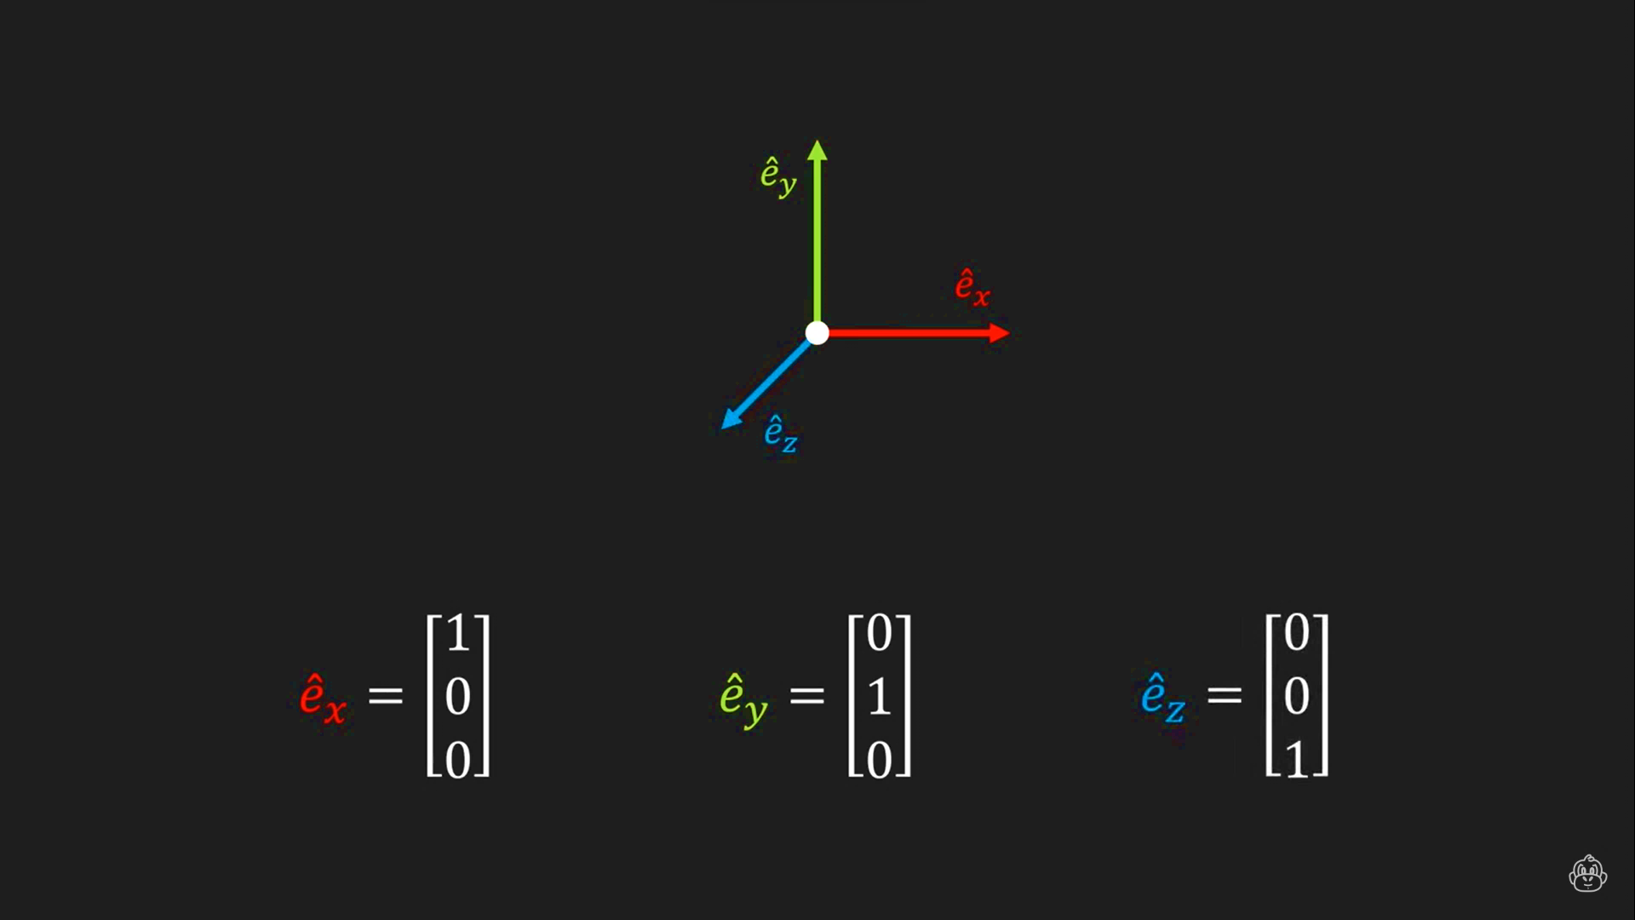
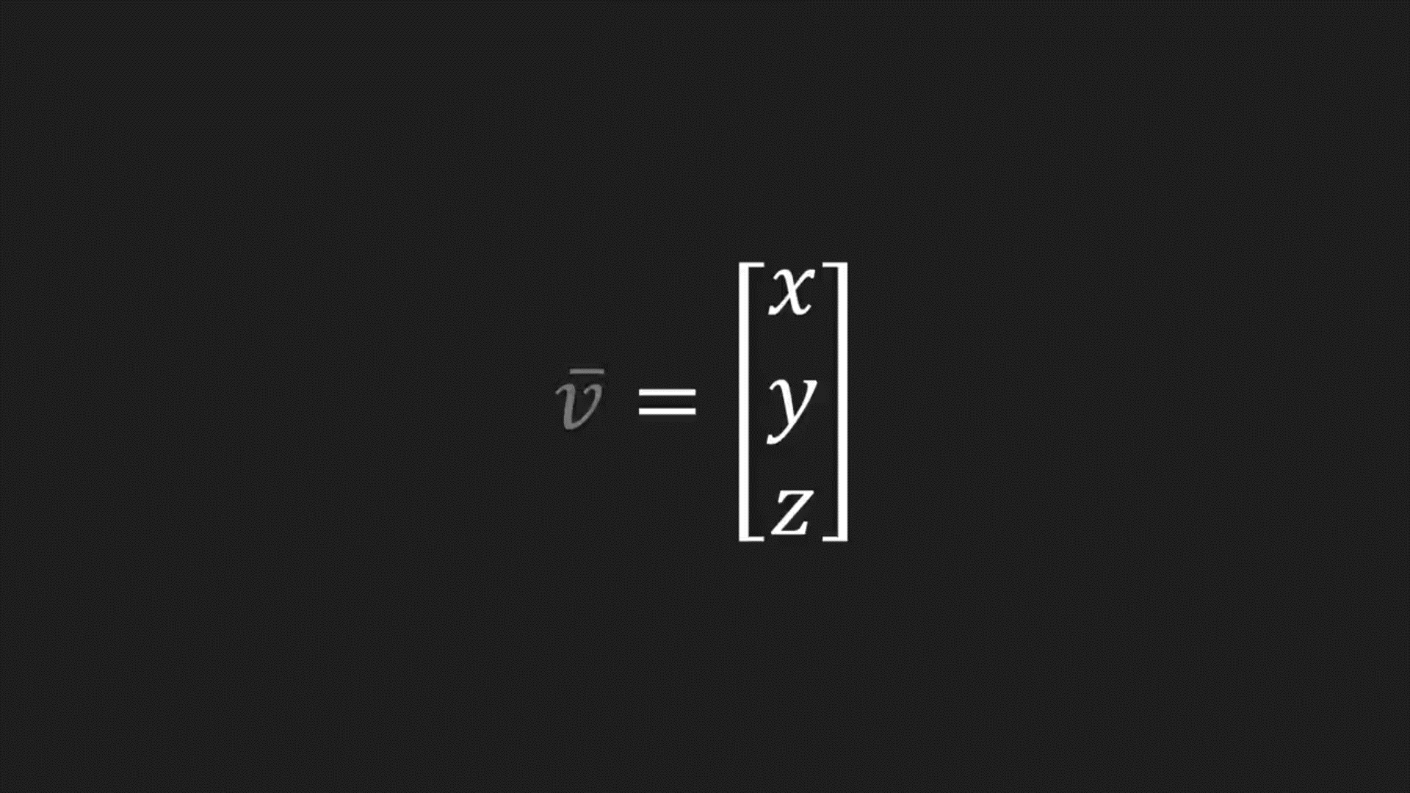
Linear Algebra for Video Game Dev
Vector
Math
Introduction
What Is Vector?
Digital Graphics
Video Game Dev
Add, Subtract and Scale Vectors
Vector Length
Normalized Vector
It is an ordered list of numbers, considered a point in the coordinate system without a position. Each vector has a length and a direction. There are many types of vectors, 2-dimensional and 3-dimensional are the common types.
3D Vector
2D Vector

Slide 19
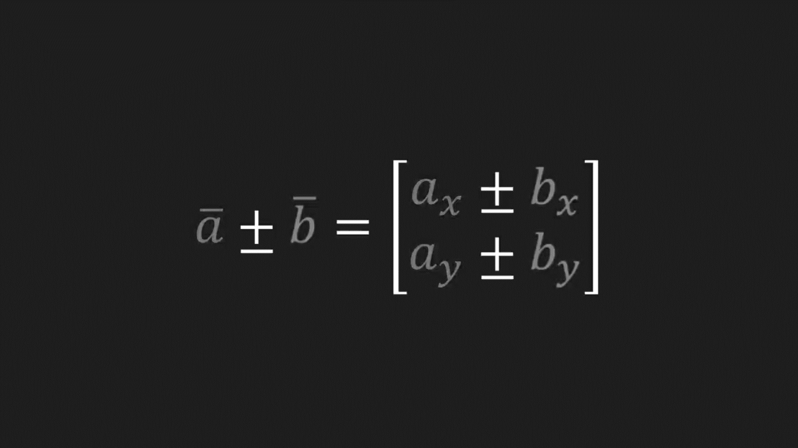
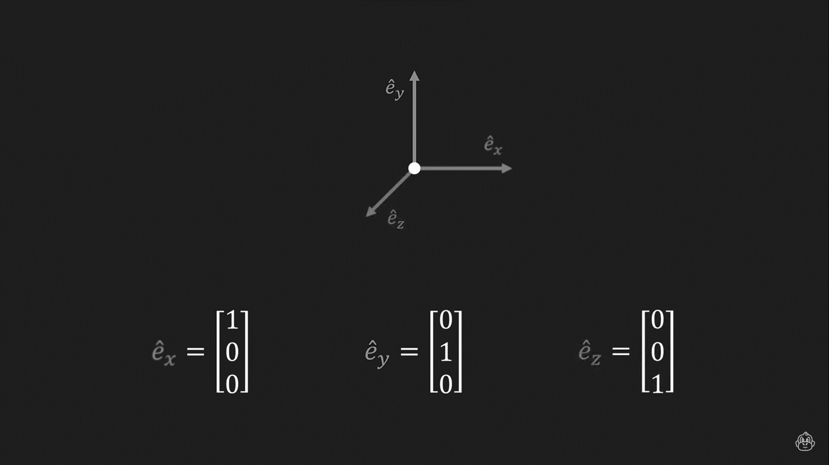
Linear Algebra for Video Game Dev
Vector
Math
Introduction
Add, Subtract and Scale Vectors
Digital Graphics
Video Game Dev
Vector Length
Normalized Vector
What Is Vector?
Add
Subtract
Scale
It is an ordered list of numbers, considered a point in the coordinate system without a position. Each vector has a length and a direction. There are many types of vectors, 2-dimensional and 3-dimensional are the common types.
3D Vector
2D Vector

Slide 20
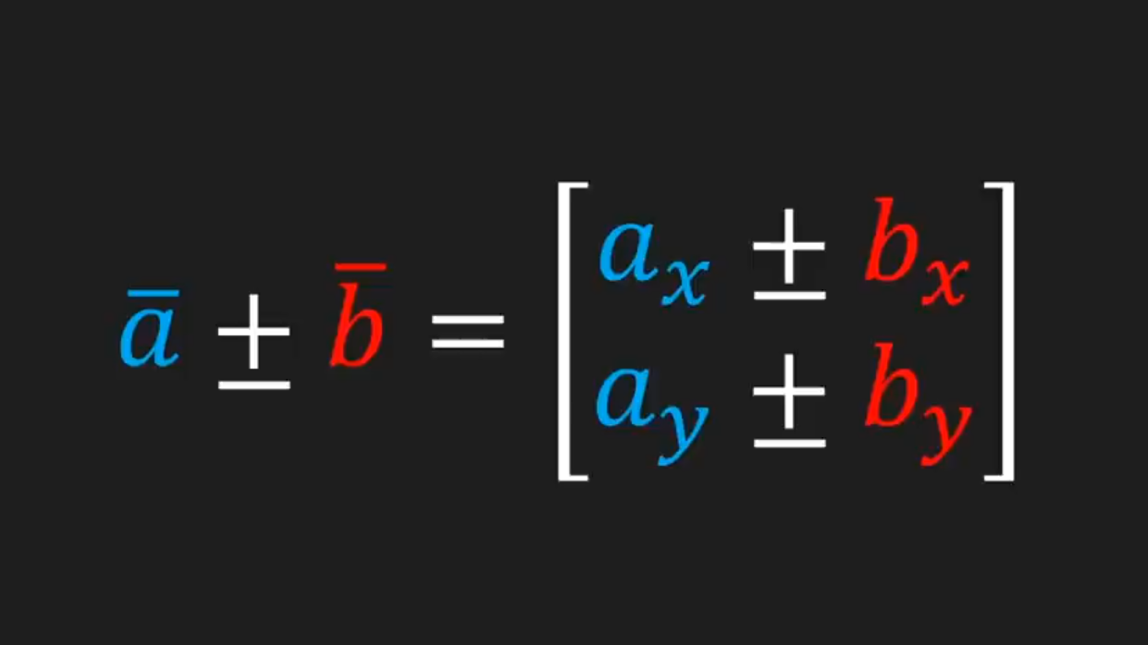
Linear Algebra for Video Game Dev
Vector
Math
Introduction
Add, Subtract and Scale Vectors
Digital Graphics
Video Game Dev
Vector Length
Normalized Vector
What Is Vector?
Add
Subtract
Scale
It is an ordered list of numbers, considered a point in the coordinate system without a position. Each vector has a length and a direction. There are many types of vectors, 2-dimensional and 3-dimensional are the common types.
Addition and Subtraction operations are vector operations that are applied between pairs of vectors (two vectors at a time).

Slide 21
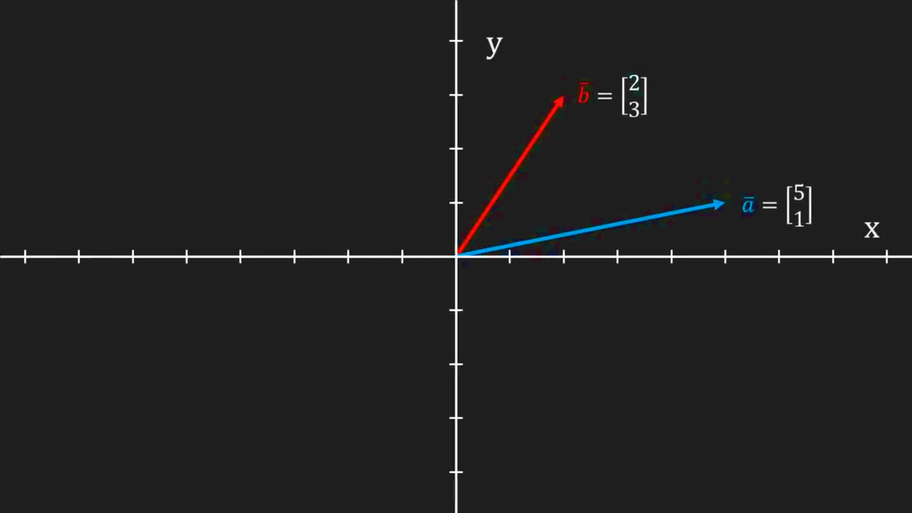
Linear Algebra for Video Game Dev
Vector
Math
Introduction
Add, Subtract and Scale Vectors
Digital Graphics
Video Game Dev
Vector Length
Normalized Vector
What Is Vector?
Add
Subtract
Scale
It is an ordered list of numbers, considered a point in the coordinate system without a position. Each vector has a length and a direction. There are many types of vectors, 2-dimensional and 3-dimensional are the common types.
Addition and Subtraction operations are vector operations that are applied between pairs of vectors (two vectors at a time).

Slide 22
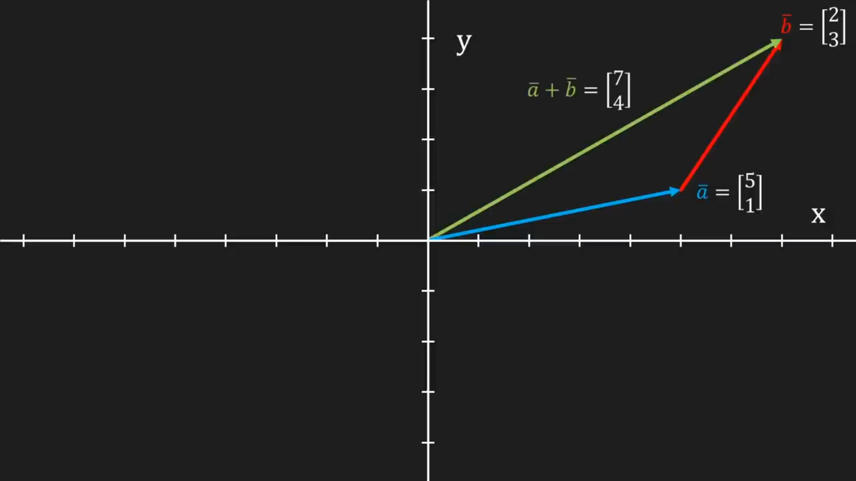
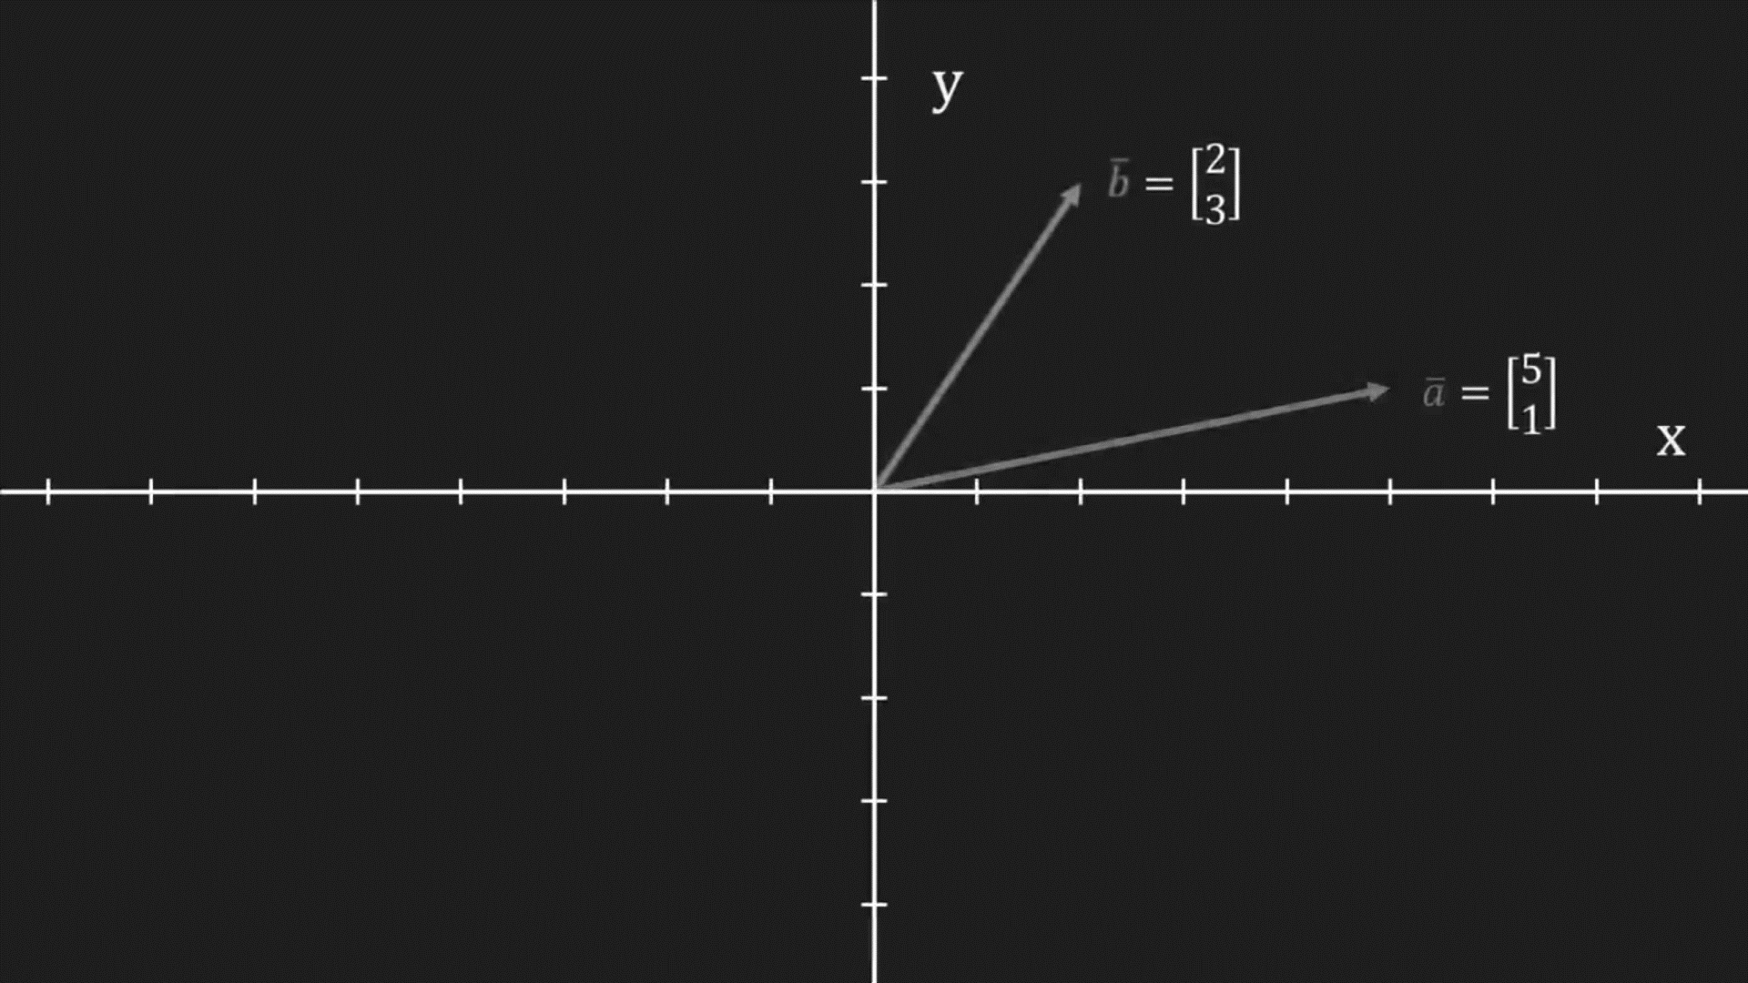
Linear Algebra for Video Game Dev
Vector
Math
Introduction
Add, Subtract and Scale Vectors
Digital Graphics
Video Game Dev
Vector Length
Normalized Vector
What Is Vector?
Add
Subtract
Scale
It is an ordered list of numbers, considered a point in the coordinate system without a position. Each vector has a length and a direction. There are many types of vectors, 2-dimensional and 3-dimensional are the common types.

Slide 23
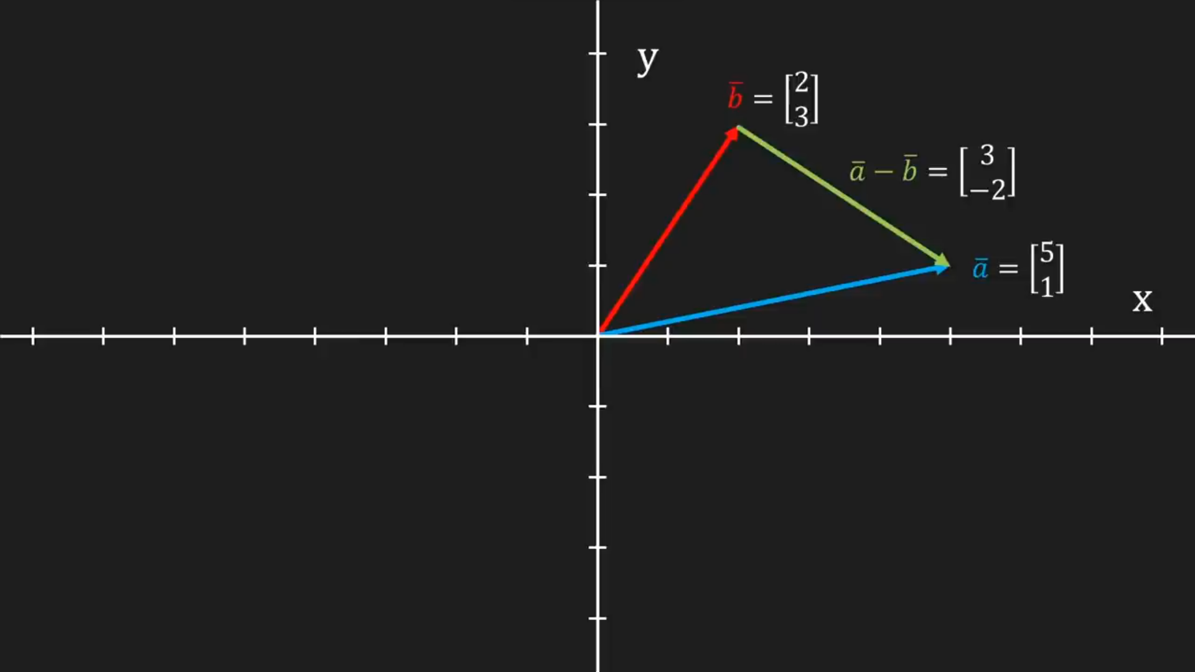
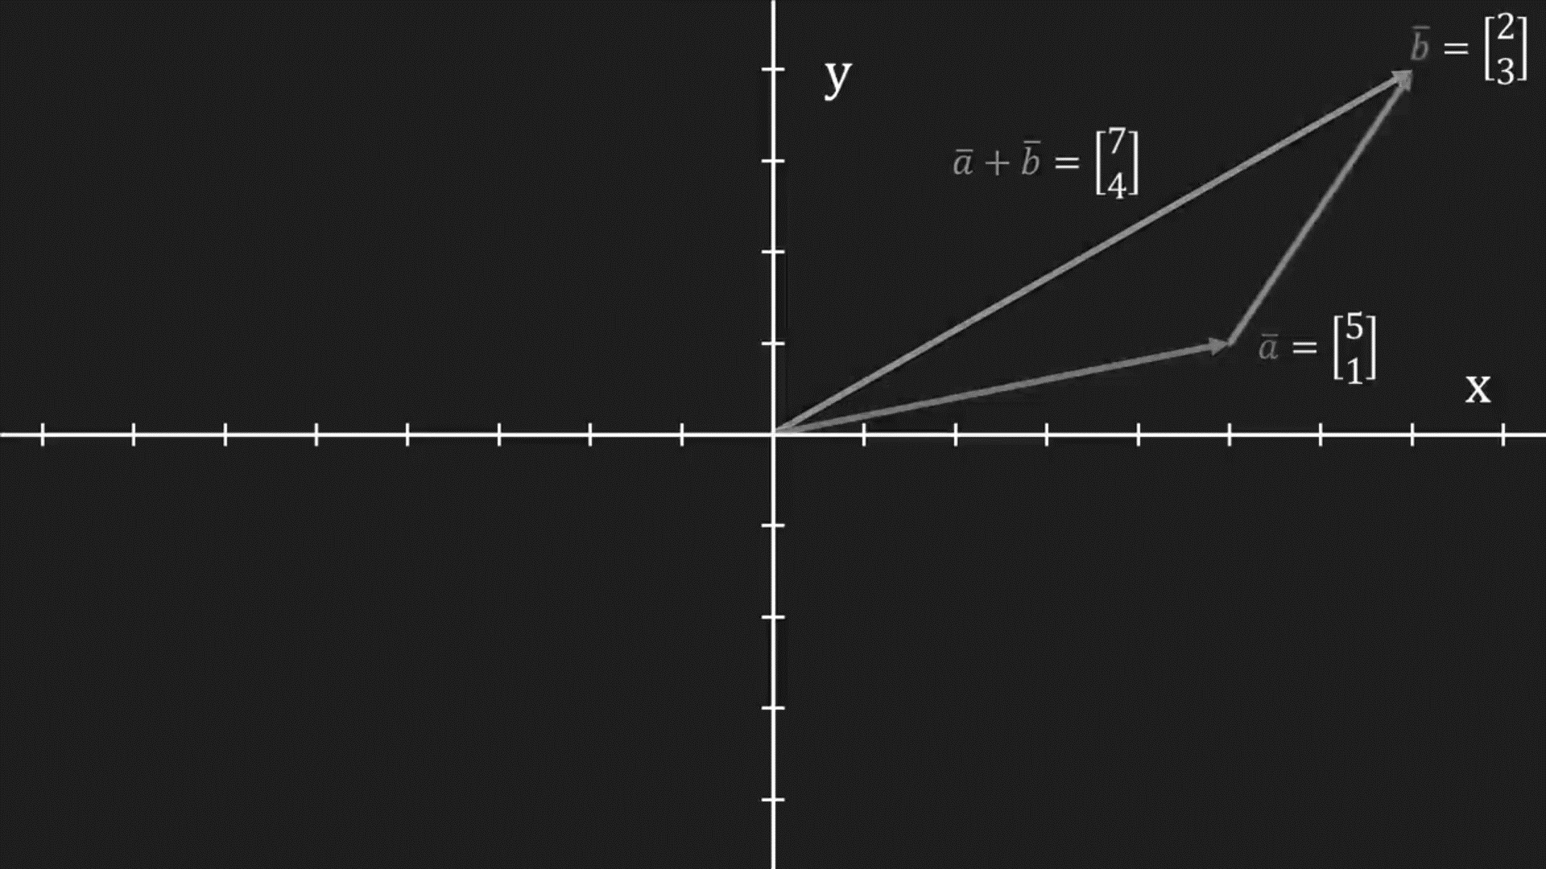
Linear Algebra for Video Game Dev
Vector
Math
Introduction
Add, Subtract and Scale Vectors
Digital Graphics
Video Game Dev
Vector Length
Normalized Vector
What Is Vector?
Add
Subtract
Scale
It is an ordered list of numbers, considered a point in the coordinate system without a position. Each vector has a length and a direction. There are many types of vectors, 2-dimensional and 3-dimensional are the common types.

Slide 24
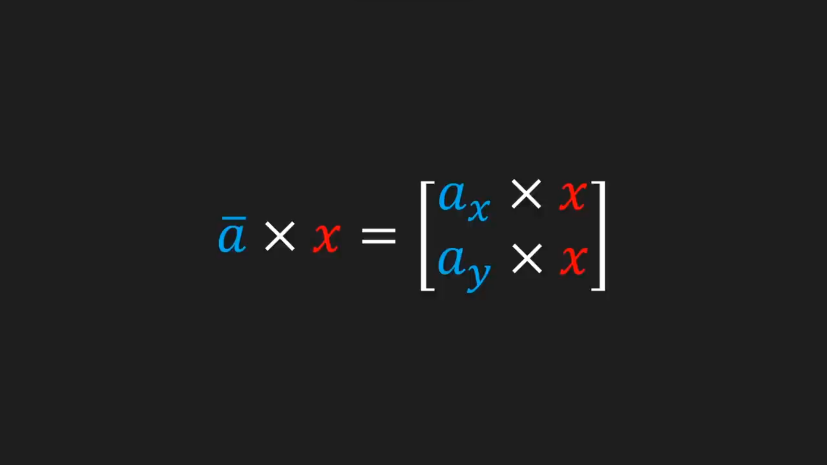
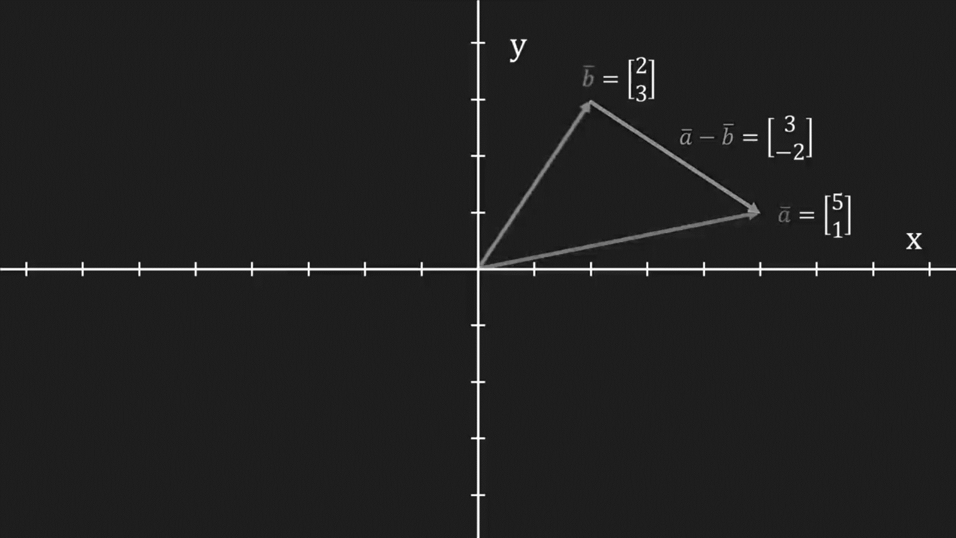
Linear Algebra for Video Game Dev
Vector
Math
Introduction
Add, Subtract and Scale Vectors
Digital Graphics
Video Game Dev
Vector Length
Normalized Vector
What Is Vector?
Add
Subtract
Scale
It is an ordered list of numbers, considered a point in the coordinate system without a position. Each vector has a length and a direction. There are many types of vectors, 2-dimensional and 3-dimensional are the common types.
Scalar operation changes the length of vectors by multiplying a vector with a positive number. Also, this operation can change the direction to the opposite by multiplying with a negative number.

Slide 25
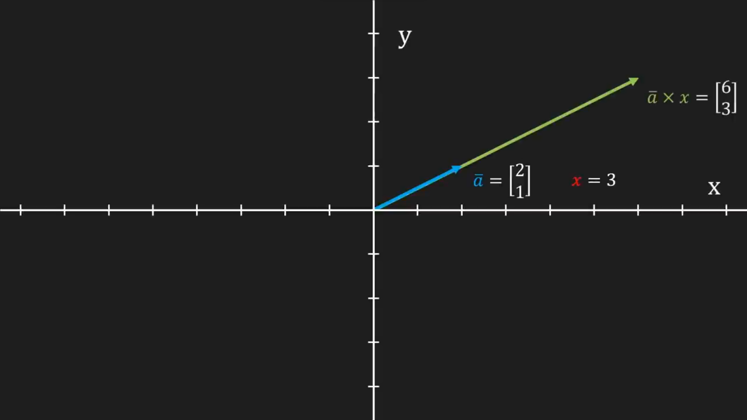
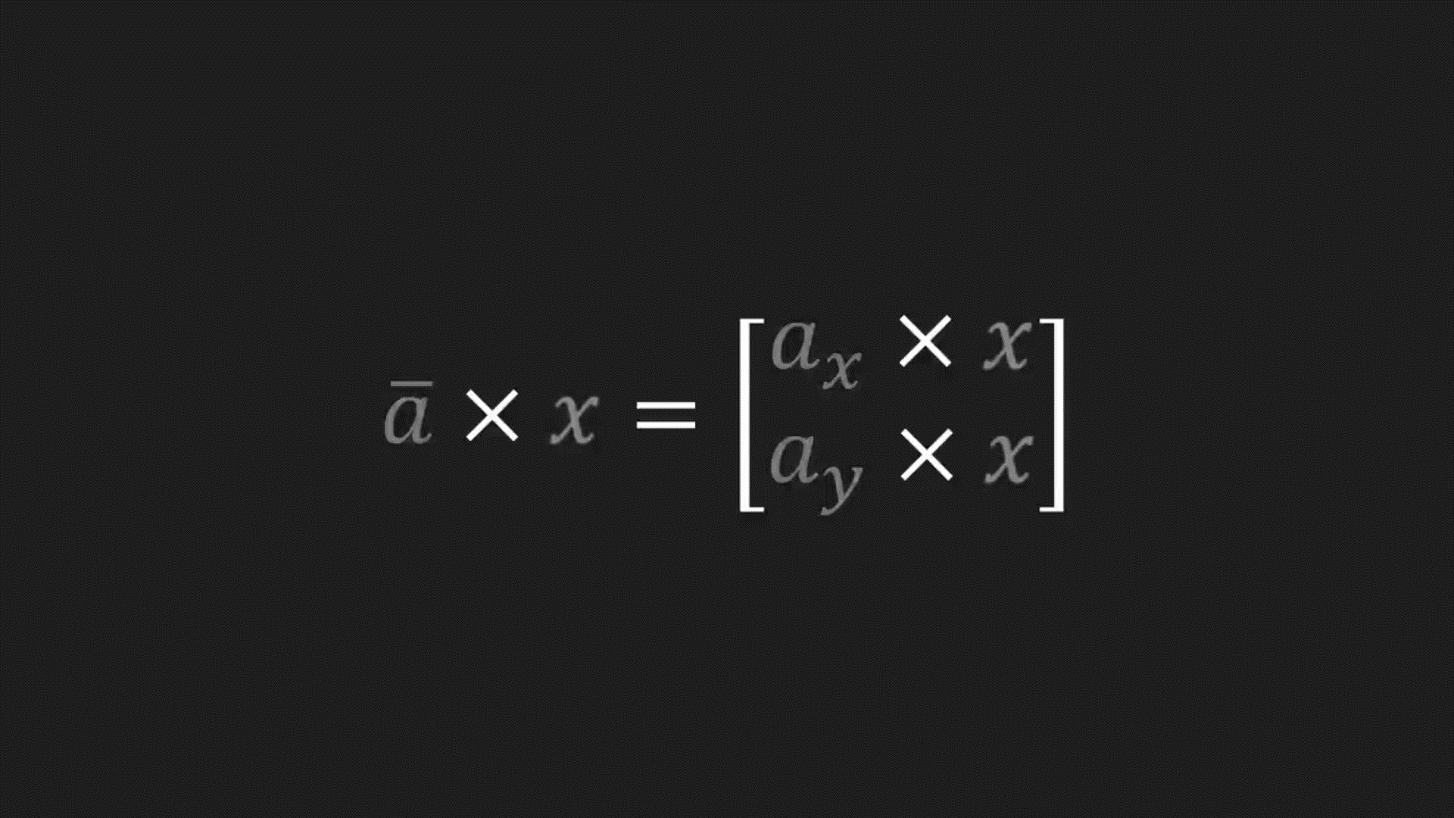
Linear Algebra for Video Game Dev
Vector
Math
Introduction
Add, Subtract and Scale Vectors
Digital Graphics
Video Game Dev
Vector Length
Normalized Vector
What Is Vector?
Add
Subtract
Scale
It is an ordered list of numbers, considered a point in the coordinate system without a position. Each vector has a length and a direction. There are many types of vectors, 2-dimensional and 3-dimensional are the common types.
Scalar operation changes the length of vectors by multiplying a vector with a positive number. Also, this operation can change the direction to the opposite by multiplying with a negative number.

Slide 26
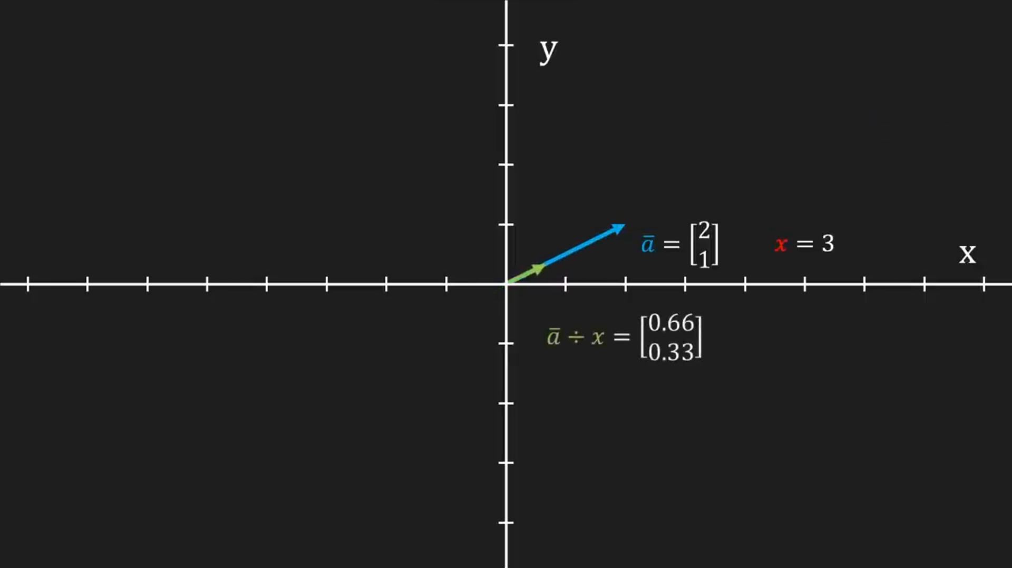
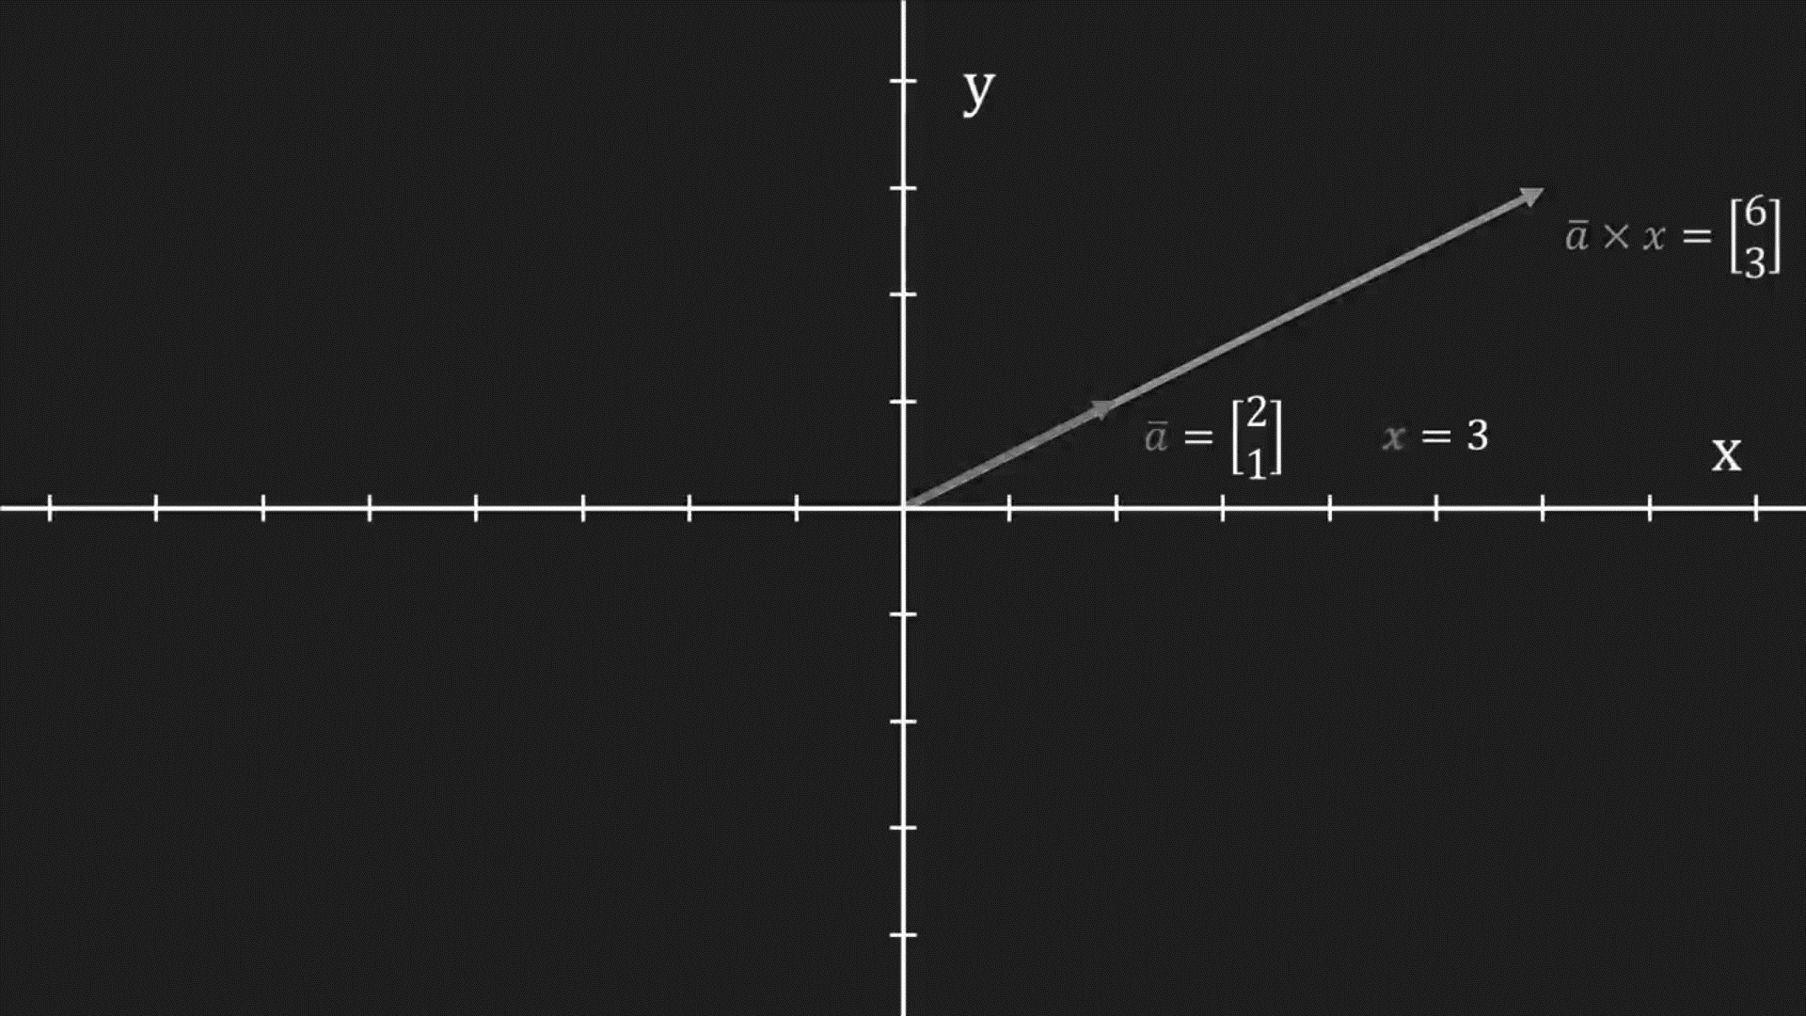
Linear Algebra for Video Game Dev
Vector
Math
Introduction
Add, Subtract and Scale Vectors
Digital Graphics
Video Game Dev
Vector Length
Normalized Vector
What Is Vector?
Add
Subtract
Scale
It is an ordered list of numbers, considered a point in the coordinate system without a position. Each vector has a length and a direction. There are many types of vectors, 2-dimensional and 3-dimensional are the common types.
Scalar operation changes the length of vectors by multiplying a vector with a positive number. Also, this operation can change the direction to the opposite by multiplying with a negative number.

Slide 27
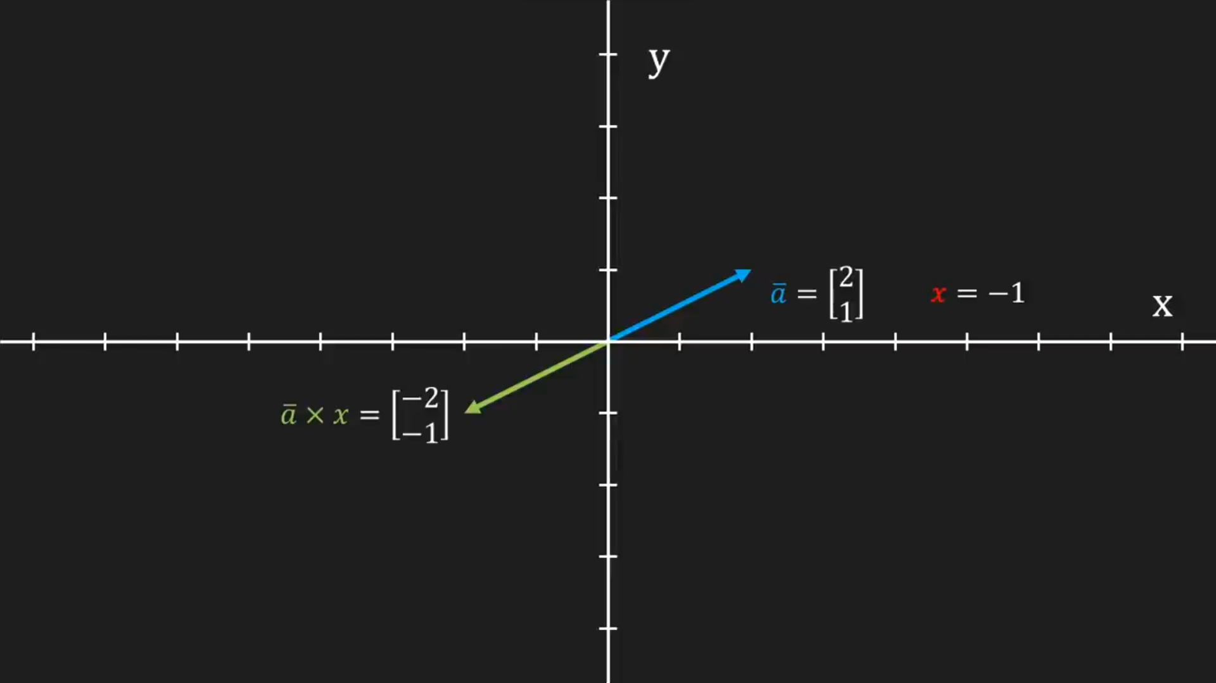
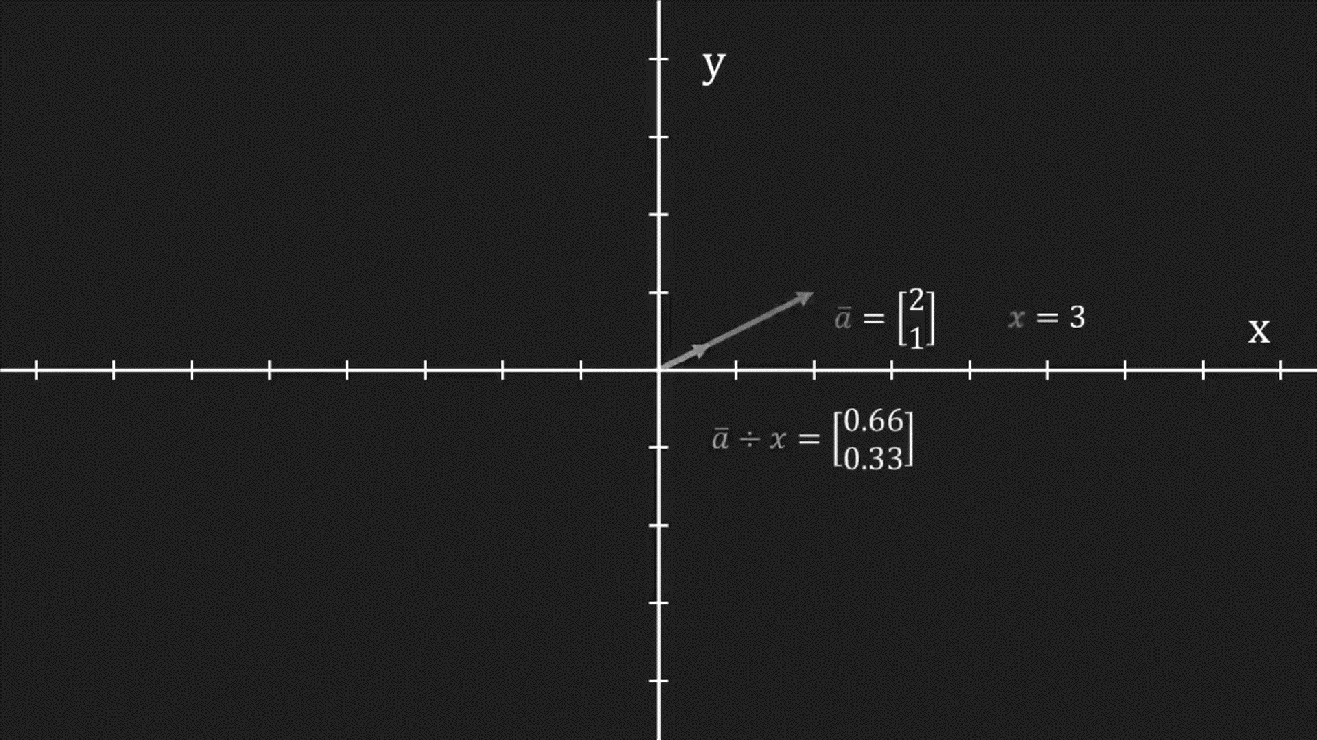
Linear Algebra for Video Game Dev
Vector
Math
Introduction
Add, Subtract and Scale Vectors
Digital Graphics
Video Game Dev
Vector Length
Normalized Vector
What Is Vector?
Add
Subtract
Scale
It is an ordered list of numbers, considered a point in the coordinate system without a position. Each vector has a length and a direction. There are many types of vectors, 2-dimensional and 3-dimensional are the common types.
Scalar operation changes the length of vectors by multiplying a vector with a positive number. Also, this operation can change the direction to the opposite by multiplying with a negative number.

Slide 28
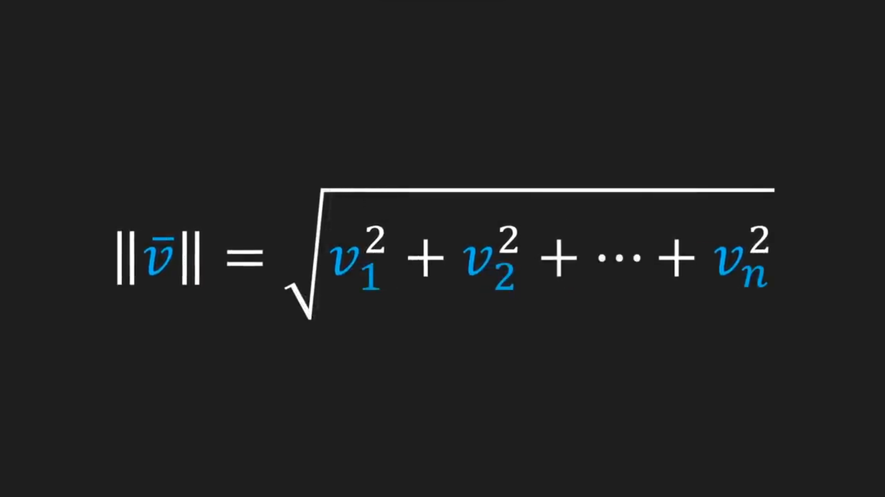
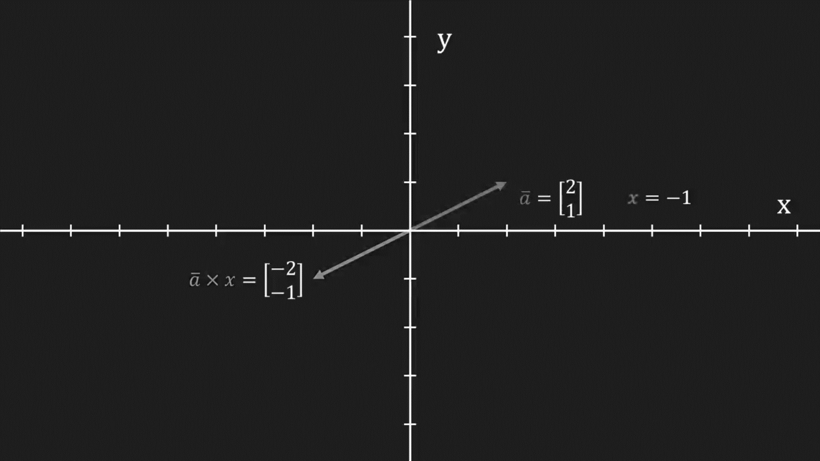
Linear Algebra for Video Game Dev
Vector
Math
Introduction
Vector Length
Digital Graphics
Video Game Dev
Normalized Vector
What Is Vector?
Add, Subtract and Scale Vectors
Scale
Add
Subtract
It is an ordered list of numbers, considered a point in the coordinate system without a position. Each vector has a length and a direction. There are many types of vectors, 2-dimensional and 3-dimensional are the common types.
Scalar operation changes the length of vectors by multiplying a vector with a positive number. Also, this operation can change the direction to the opposite by multiplying with a negative number.

Slide 29
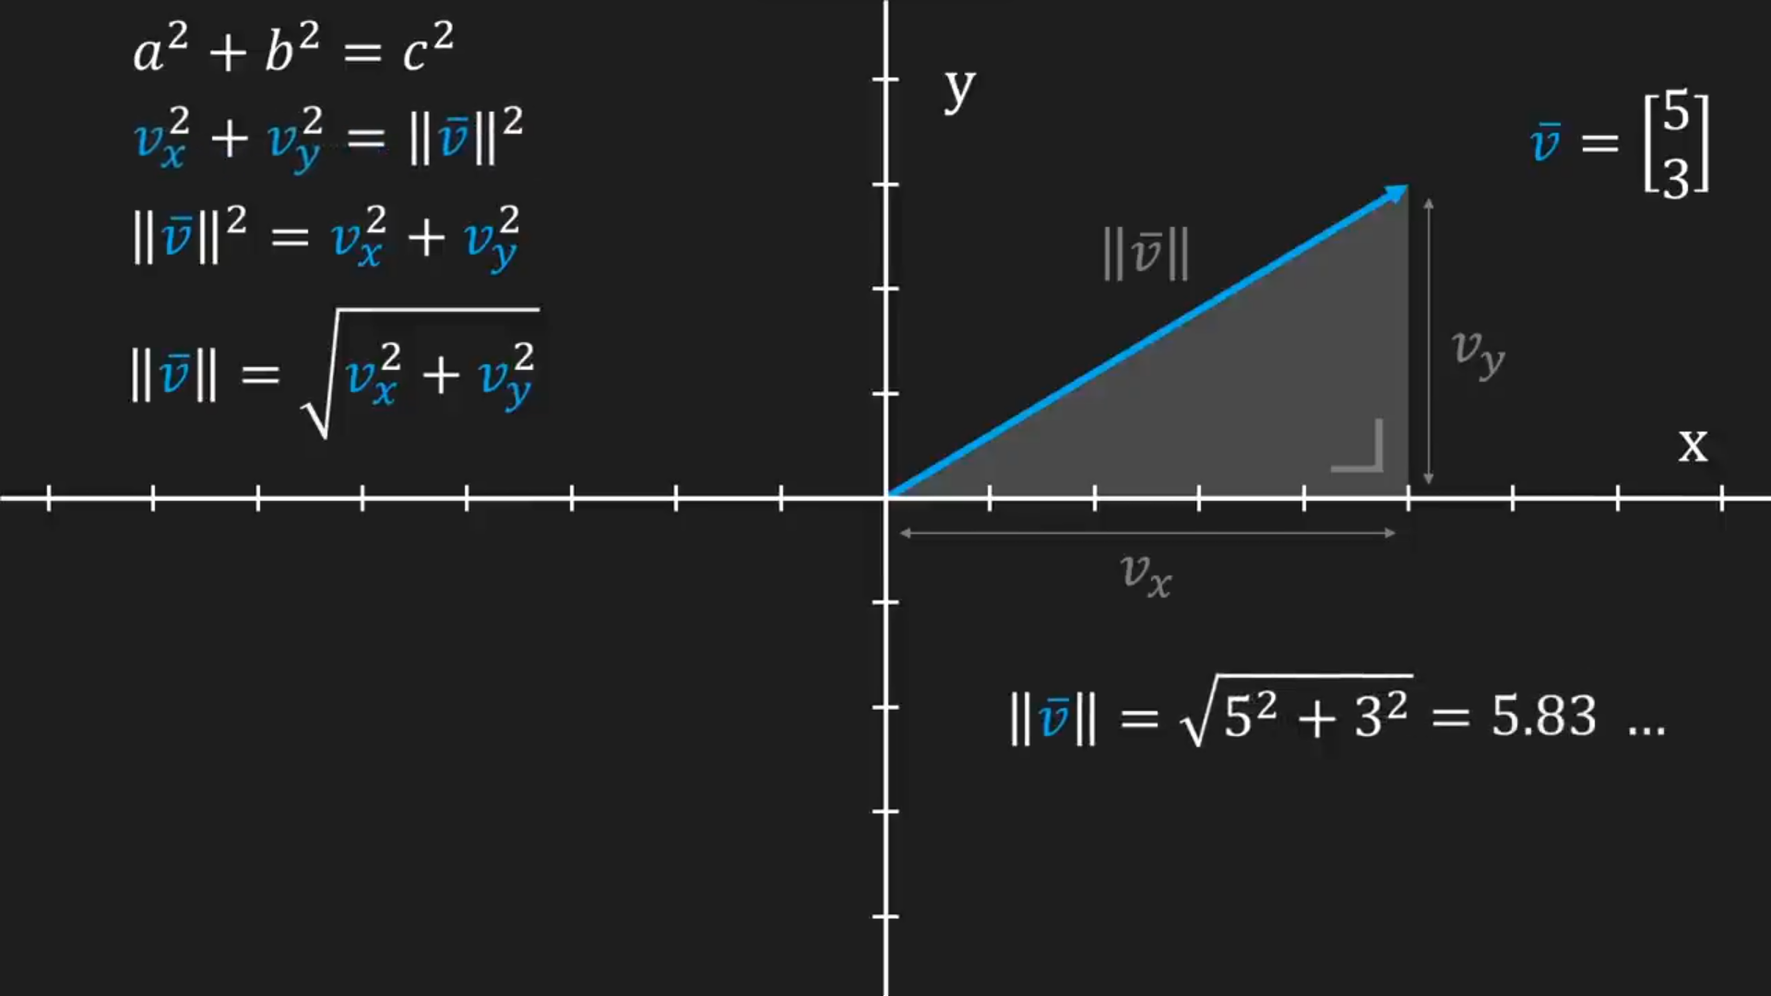
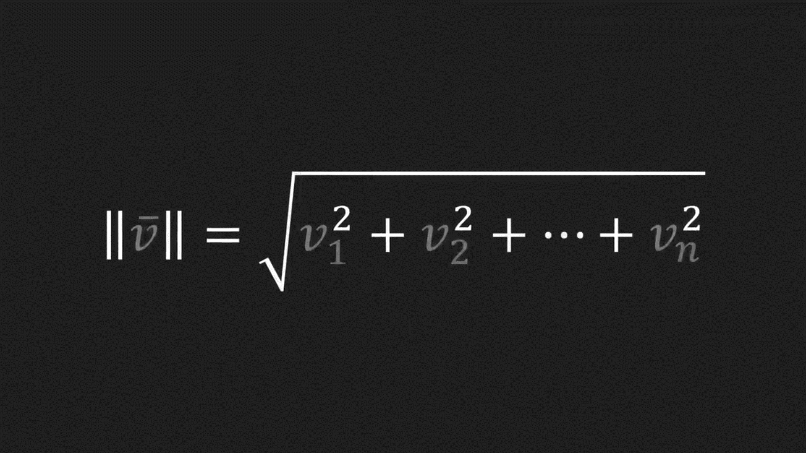
Linear Algebra for Video Game Dev
Vector
Math
Introduction
Vector Length
Digital Graphics
Video Game Dev
Normalized Vector
What Is Vector?
Add, Subtract and Scale Vectors

Slide 30
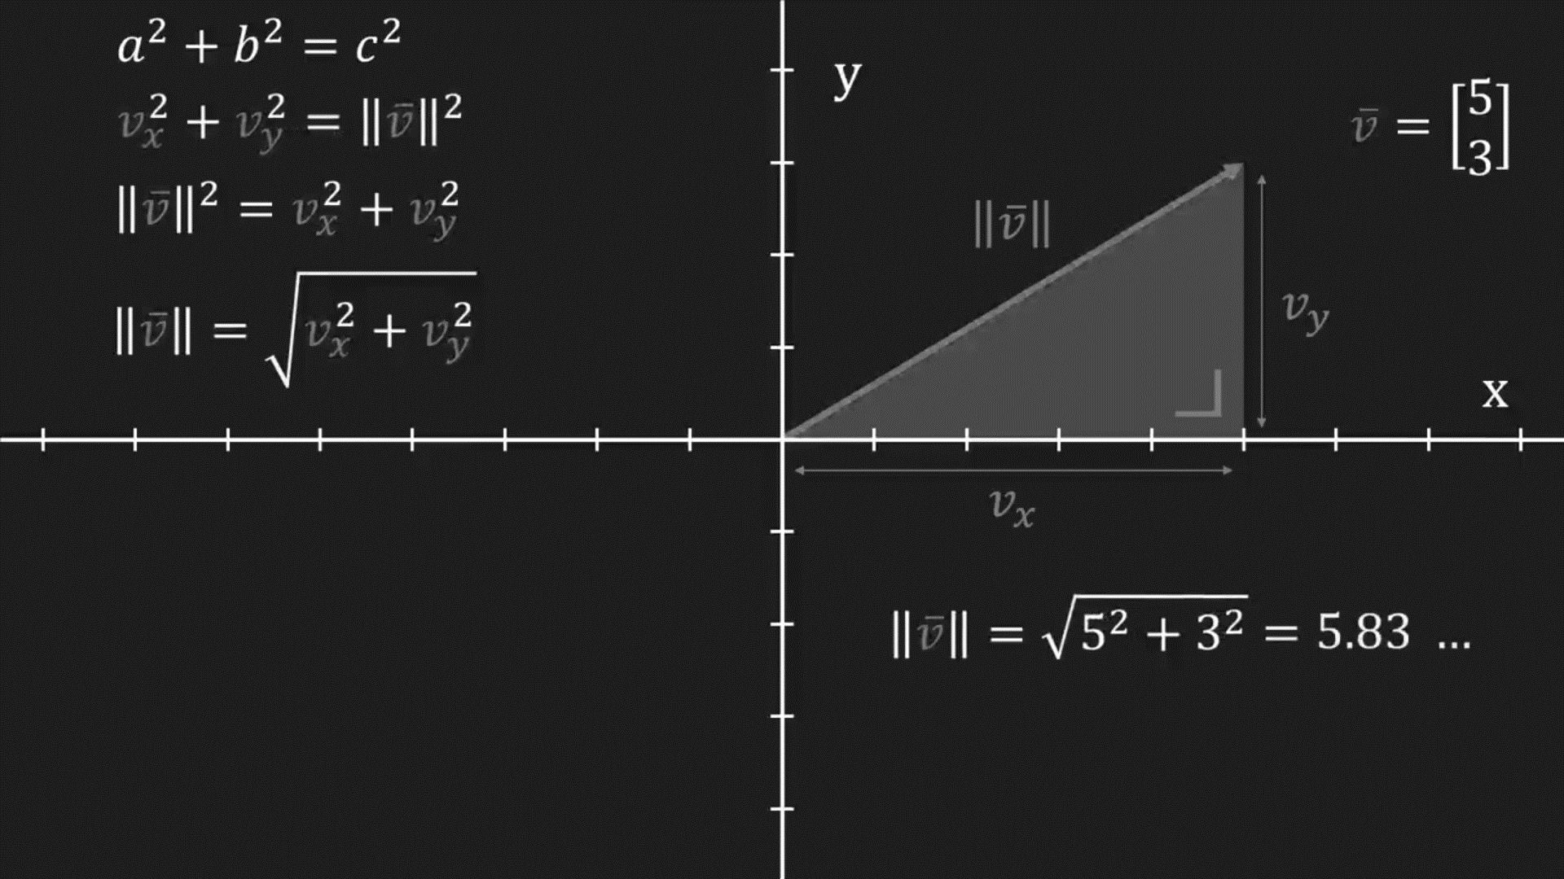
Linear Algebra for Video Game Dev
Vector
Math
Introduction
Normalized Vector
Digital Graphics
Video Game Dev
What Is Vector?
Add, Subtract and Scale Vectors
Vector Length
It is also called Unit Vector. It has a length of between -1 and 1, and it is calculated by dividing the vector by its length. Vectors can be found by multiplying the components by their respective Unit Vectors and then summing them.

Slide 31
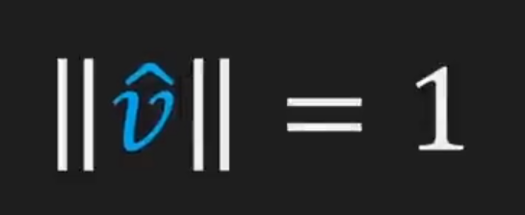
Linear Algebra for Video Game Dev
Vector
Math
Introduction
Normalized Vector
Digital Graphics
Video Game Dev
What Is Vector?
Add, Subtract and Scale Vectors
Vector Length
It is also called Unit Vector. It has a length of between -1 and 1, and it is calculated by dividing the vector by its length. Vectors can be found by multiplying the components by their respective Unit Vectors and then summing them.

Slide 32
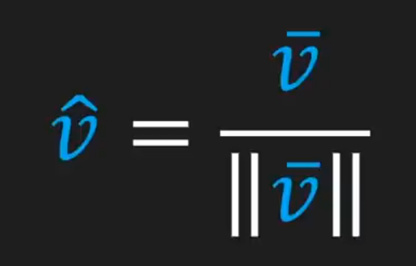
Linear Algebra for Video Game Dev
Vector
Math
Introduction
Normalized Vector
Digital Graphics
Video Game Dev
What Is Vector?
Add, Subtract and Scale Vectors
Vector Length
It is also called Unit Vector. It has a length of between -1 and 1, and it is calculated by dividing the vector by its length. Vectors can be found by multiplying the components by their respective Unit Vectors and then summing them.

Slide 33
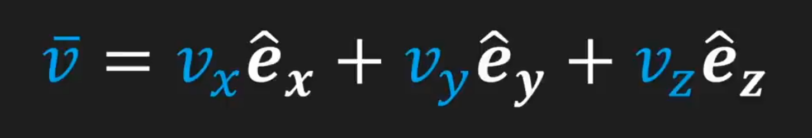
Linear Algebra for Video Game Dev
Vector
Math
Introduction
Normalized Vector
Digital Graphics
Video Game Dev
What Is Vector?
Add, Subtract and Scale Vectors
Vector Length
It is also called Unit Vector. It has a length of between -1 and 1, and it is calculated by dividing the vector by its length. Vectors can be found by multiplying the components by their respective Unit Vectors and then summing them.

Slide 34
Linear Algebra for Video Game Dev
Vector
Math
Introduction
Normalized Vector
Digital Graphics
Video Game Dev
What Is Vector?
Add, Subtract and Scale Vectors
Vector Length
It is also called Unit Vector. It has a length of between -1 and 1, and it is calculated by dividing the vector by its length. Vectors can be found by multiplying the components by their respective Unit Vectors and then summing them.

Slide 35
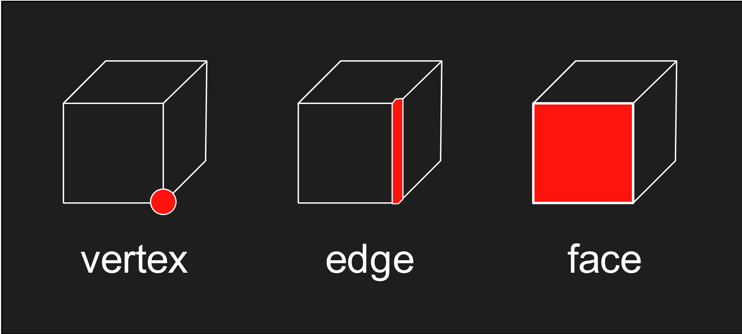
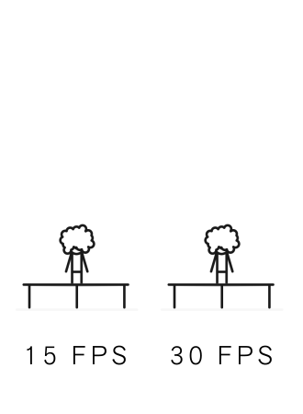
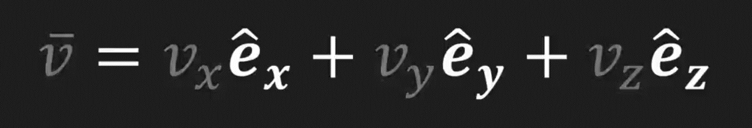
Linear Algebra for Video Game Dev
Math
Vector
Introduction
Digital Graphics
Video Game Dev
Add, Subtract and Scale Vectors
Normalized Vector
What Is Vector?
Vector Length
Vertex
Edge
Face
Frames
It is also called Unit Vector. It has a length of between -1 and 1, and it is calculated by dividing the vector by its length. Vectors can be found by multiplying the components by their respective Unit Vectors and then summing them.

Slide 36
Linear Algebra for Video Game Dev
Digital Graphics
Math
Vector
Introduction
Video Game Dev
Vertex
Edge
Face
Frames
The vertex is the basic unit of 3D modeling, and it stores data about the model, such as the position, the color, the normal and so on. The difference between a vertex and a vector is that a vector is just a position without relation, while a vertex contains more information.

Slide 37
Linear Algebra for Video Game Dev
Digital Graphics
Math
Vector
Introduction
Video Game Dev
Vertex
Edge
Face
Frames
The vertex is the basic unit of 3D modeling, and it stores data about the model, such as the position, the color, the normal and so on. The difference between a vertex and a vector is that a vector is just a position without relation, while a vertex contains more information.
The edge is a line that connects two vertices, and it makes a transition between the data of the two vertices. The edge is considered a visual representation of a vector that starts from the first vertex and ends at the second vertex.

Slide 38
Linear Algebra for Video Game Dev
Digital Graphics
Math
Vector
Introduction
Video Game Dev
Vertex
Edge
Face
Frames
The edge is a line that connects two vertices, and it makes a transition between the data of the two vertices. The edge is considered a visual representation of a vector that starts from the first vertex and ends at the second vertex.
The face is a combination of two triangles where they are shared with two vertices. Each triangle is ended in the started vertex (closed shape). A single face’s vertices share the same normal directions. As stander faces should consist of four vertices.

Slide 39
Linear Algebra for Video Game Dev
Digital Graphics
Math
Vector
Introduction
Video Game Dev
Vertex
Edge
Face
Frames
The face is a combination of two triangles where they are shared with two vertices. Each triangle is ended in the started vertex (closed shape). A single face’s vertices share the same normal directions. As stander faces should consist of four vertices.
The frame is a picture that is drawn (rendered). Video games render frames at runtime, so the PC has to have the ability to render a number of pictures per a second. If the frames are more than 30 per a second, the human eyes will not see drops frames, so everything will be smooth.

Slide 40
Linear Algebra for Video Game Dev
Math
Vector
Digital Graphics
Introduction
Video Game Dev
Transformation
Projection
Dot Product
Vertex
Edge
Face
Frames
The frame is a picture that is drawn (rendered). Video games render frames at runtime, so the PC has to have the ability to render a number of pictures per a second. If the frames are more than 30 per a second, the human eyes will not see drops frames, so everything will be smooth.

Slide 41
Linear Algebra for Video Game Dev
Video Game Dev
Math
Vector
Digital Graphics
Introduction
Transformation
Dot Product
Projection
Rotation
Scaling
Shearing
Translation
Linear Transformations
Non-Linear Transformation

Slide 42
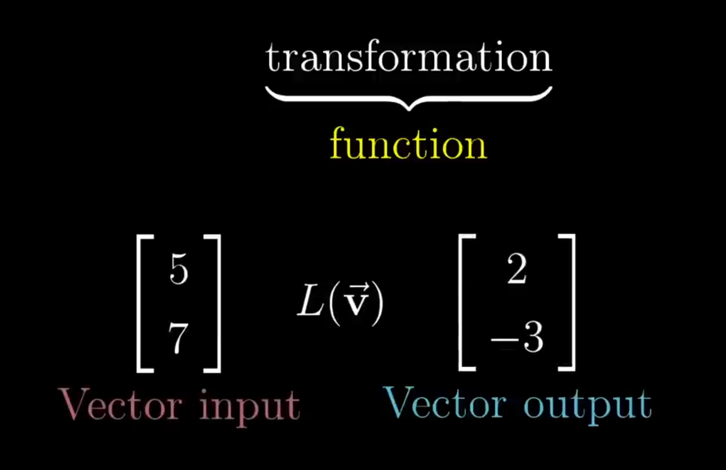
Linear Algebra for Video Game Dev
Transformation
Video Game Dev
Math
Vector
Digital Graphics
Introduction
Rotation
Scaling
Shearing
Translation
Linear Transformations
Non-Linear Transformation
Dot Product
Projection
Transformations are like functions that get inputs and return an output. However, the difference between them is that in function the inputs are numbers, while in transformation the inputs are vectors. Transformation is named like this because the visual behavior of the output looks like it’s moving.

Slide 43
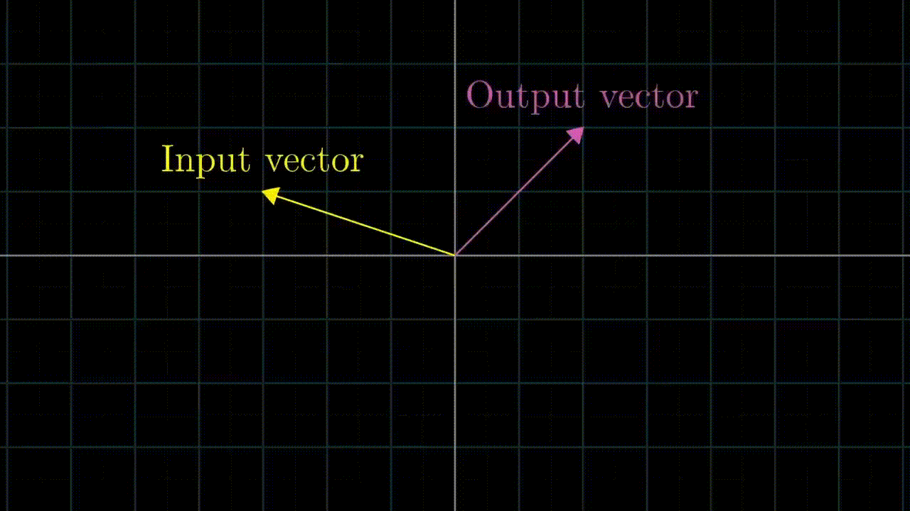
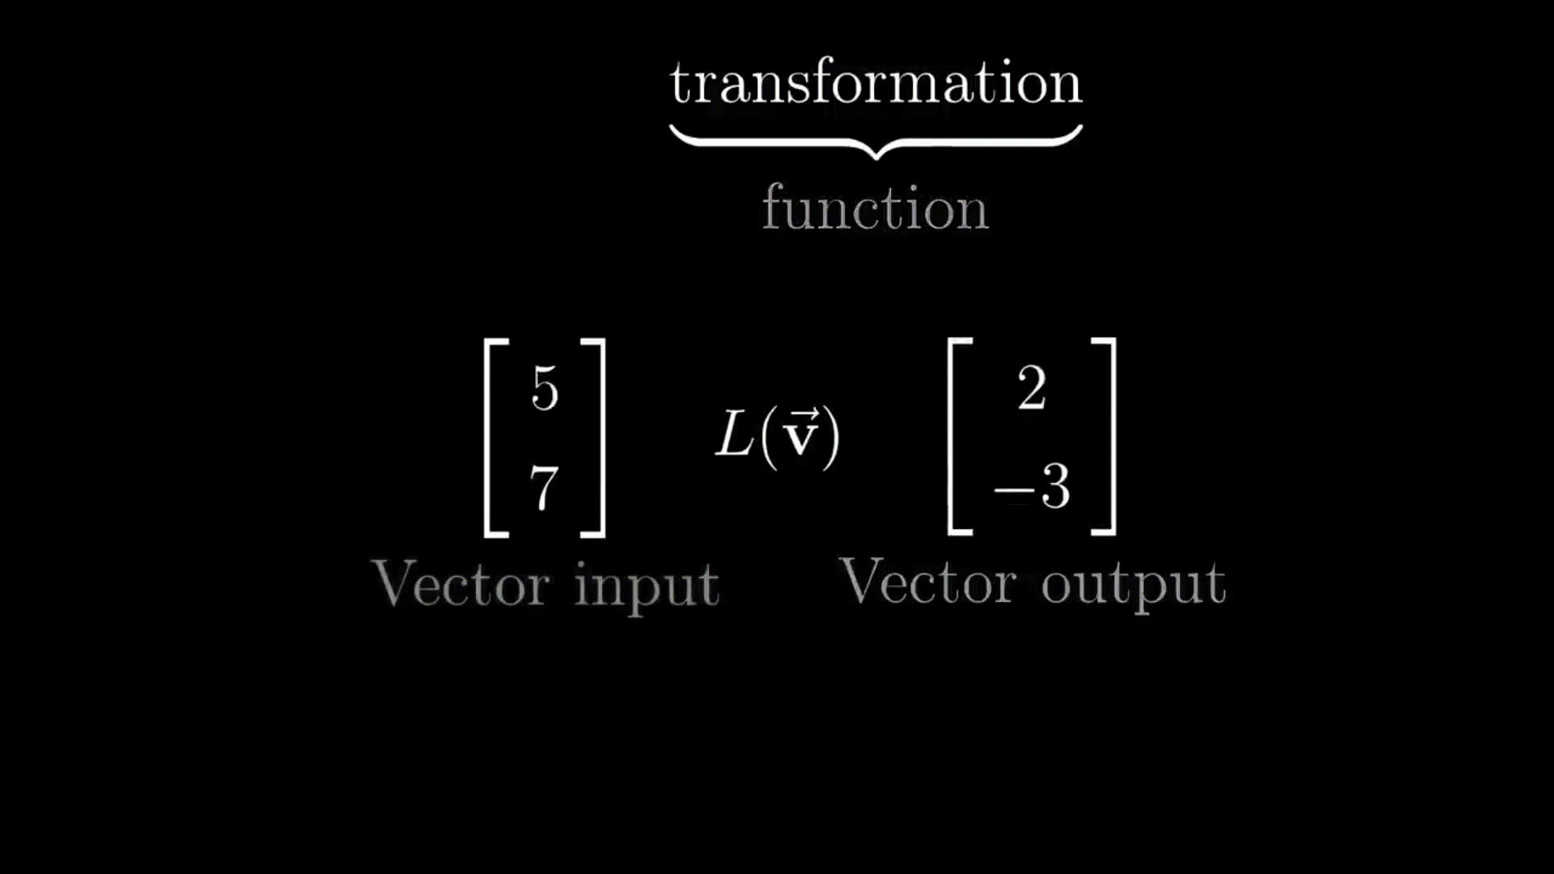
Linear Algebra for Video Game Dev
Transformation
Video Game Dev
Math
Vector
Digital Graphics
Introduction
Rotation
Scaling
Shearing
Translation
Linear Transformations
Non-Linear Transformation
Dot Product
Projection
Transformations are like functions that get inputs and return an output. However, the difference between them is that in function the inputs are numbers, while in transformation the inputs are vectors. Transformation is named like this because the visual behavior of the output looks like it’s moving.

Slide 44
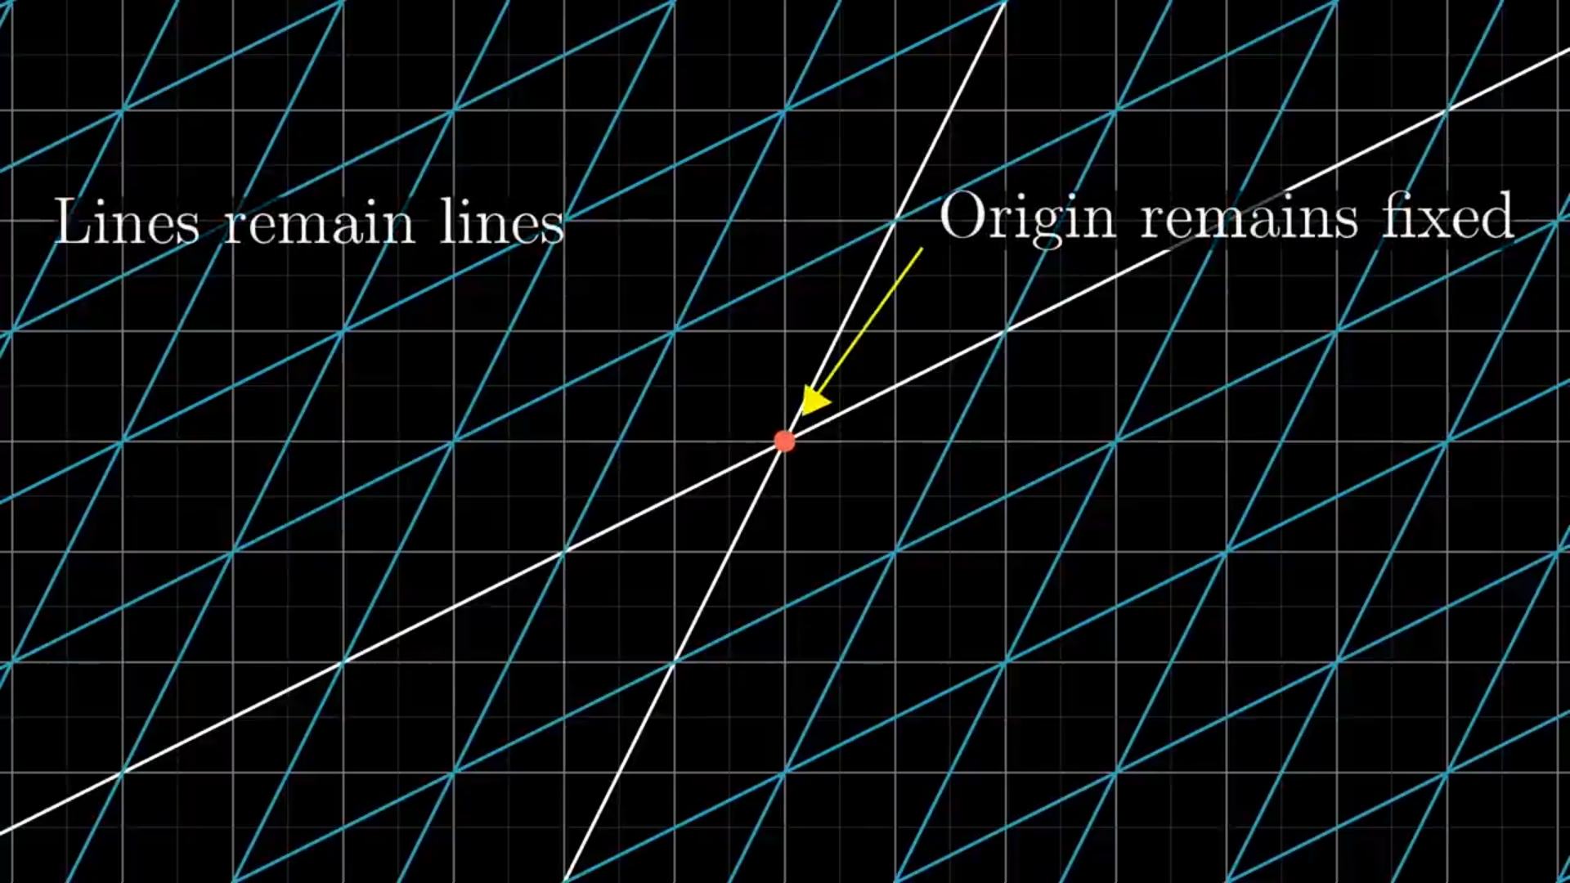
Linear Algebra for Video Game Dev
Transformation
Video Game Dev
Math
Vector
Digital Graphics
Introduction
Rotation
Scaling
Shearing
Translation
Linear Transformations
Non-Linear Transformation
Dot Product
Projection
To say that the transformation is linear, the following rules must be checked:-
1) Lines must stay lines without getting curved.
2) Origin must stay fixed after the movement.
3) Diagonal lines must stay lines without getting curved.
Any breaks in these rules make the transformation non-linear.
Transformations are like functions that get inputs and return an output. However, the difference between them is that in function the inputs are numbers, while in transformation the inputs are vectors. Transformation is named like this because the visual behavior of the output looks like it’s moving.

Slide 45
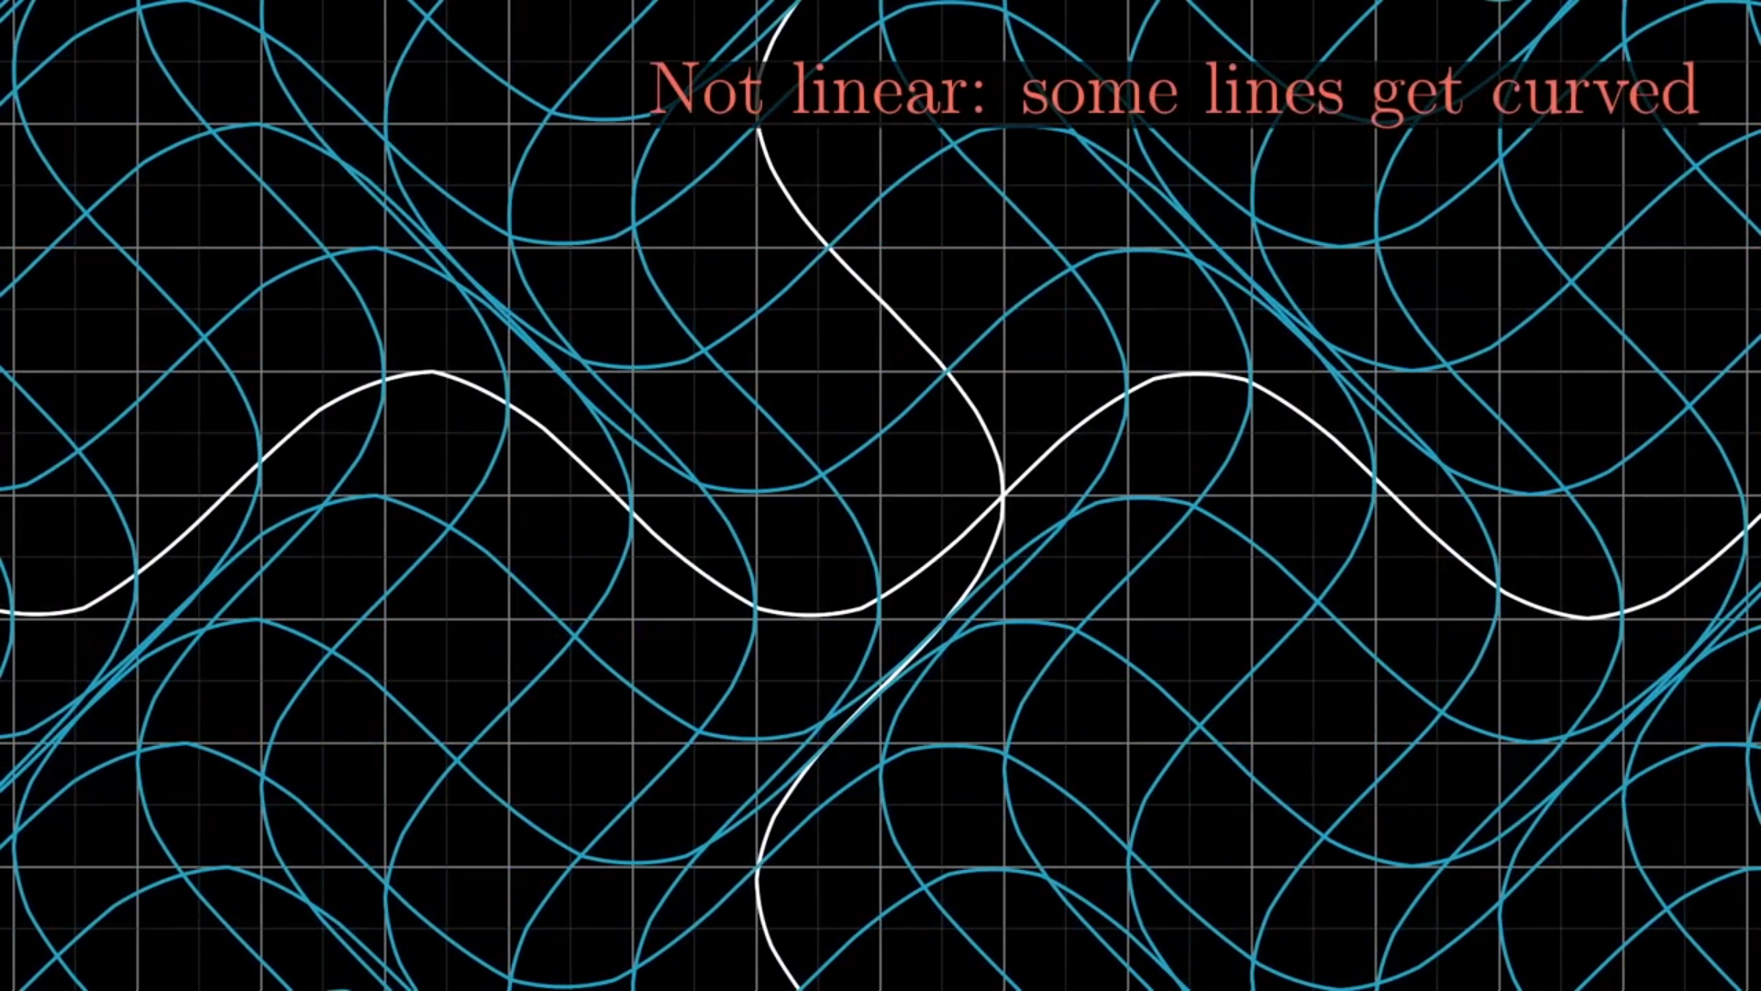
Linear Algebra for Video Game Dev
Transformation
Video Game Dev
Math
Vector
Digital Graphics
Introduction
Rotation
Scaling
Shearing
Translation
Linear Transformations
Non-Linear Transformation
Dot Product
Projection
To say that the transformation is linear, the following rules must be checked:-
1) Lines must stay lines without getting curved.
2) Origin must stay fixed after the movement.
3) Diagonal lines must stay lines without getting curved.
Any breaks in these rules make the transformation non-linear.
Transformations are like functions that get inputs and return an output. However, the difference between them is that in function the inputs are numbers, while in transformation the inputs are vectors. Transformation is named like this because the visual behavior of the output looks like it’s moving.

Slide 46
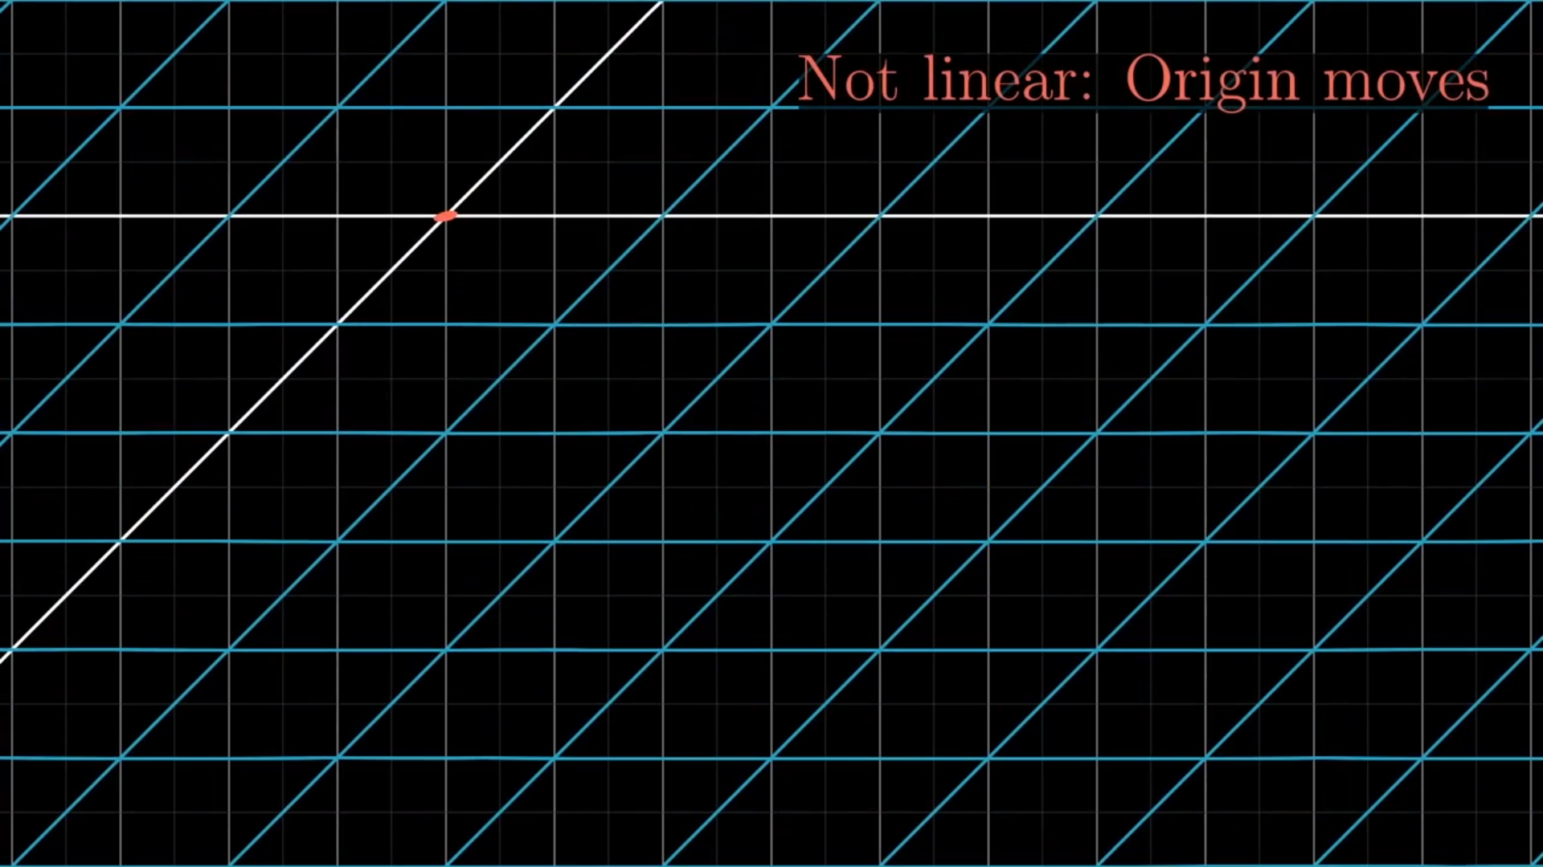
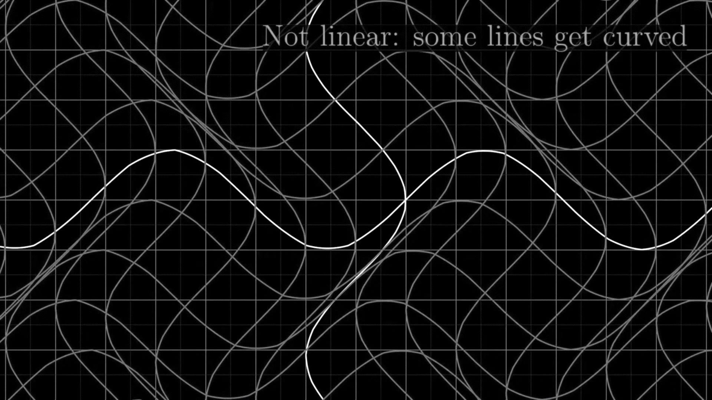
Linear Algebra for Video Game Dev
Transformation
Video Game Dev
Math
Vector
Digital Graphics
Introduction
Rotation
Scaling
Shearing
Translation
Linear Transformations
Non-Linear Transformation
Dot Product
Projection
To say that the transformation is linear, the following rules must be checked:-
1) Lines must stay lines without getting curved.
2) Origin must stay fixed after the movement.
3) Diagonal lines must stay lines without getting curved.
Any breaks in these rules make the transformation non-linear.
Transformations are like functions that get inputs and return an output. However, the difference between them is that in function the inputs are numbers, while in transformation the inputs are vectors. Transformation is named like this because the visual behavior of the output looks like it’s moving.

Slide 47
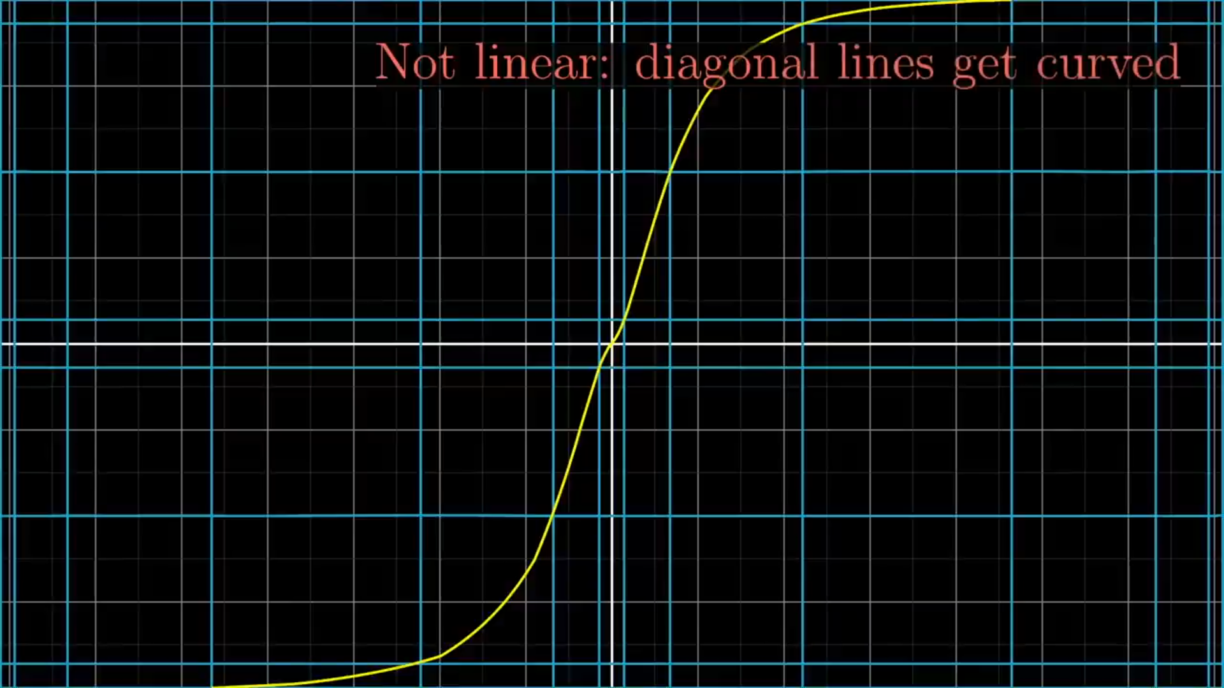
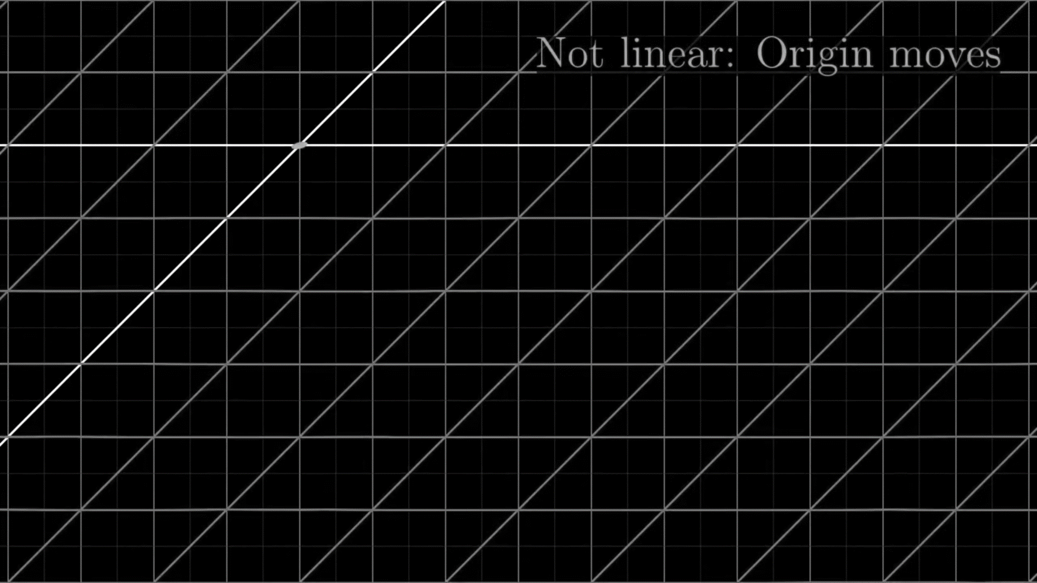
Linear Algebra for Video Game Dev
Transformation
Video Game Dev
Math
Vector
Digital Graphics
Introduction
Rotation
Scaling
Shearing
Translation
Linear Transformations
Non-Linear Transformation
Dot Product
Projection
To say that the transformation is linear, the following rules must be checked:-
1) Lines must stay lines without getting curved.
2) Origin must stay fixed after the movement.
3) Diagonal lines must stay lines without getting curved.
Any breaks in these rules make the transformation non-linear.
Transformations are like functions that get inputs and return an output. However, the difference between them is that in function the inputs are numbers, while in transformation the inputs are vectors. Transformation is named like this because the visual behavior of the output looks like it’s moving.

Slide 48



Linear Algebra for Video Game Dev
Transformation
Video Game Dev
Math
Vector
Digital Graphics
Introduction
Rotation
Scaling
Shearing
Translation
Linear Transformations
Non-Linear Transformation
Dot Product
Projection
Transformations are like functions that get inputs and return an output. However, the difference between them is that in function the inputs are numbers, while in transformation the inputs are vectors. Transformation is named like this because the visual behavior of the output looks like it’s moving.
To say that the transformation is linear, the following rules must be checked:-
1) Lines must stay lines without getting curved.
2) Origin must stay fixed after the movement.
3) Diagonal lines must stay lines without getting curved.
Any breaks in these rules make the transformation non-linear.

Slide 49


Linear Algebra for Video Game Dev
Transformation
Video Game Dev
Math
Vector
Digital Graphics
Introduction
Rotation
Scaling
Shearing
Translation
Linear Transformations
Non-Linear Transformation
Dot Product
Projection
Transformations are like functions that get inputs and return an output. However, the difference between them is that in function the inputs are numbers, while in transformation the inputs are vectors. Transformation is named like this because the visual behavior of the output looks like it’s moving.
To say that the transformation is linear, the following rules must be checked:-
1) Lines must stay lines without getting curved.
2) Origin must stay fixed after the movement.
3) Diagonal lines must stay lines without getting curved.
Any breaks in these rules make the transformation non-linear.

Slide 50


Linear Algebra for Video Game Dev
Transformation
Video Game Dev
Math
Vector
Digital Graphics
Introduction
Rotation
Scaling
Shearing
Translation
Linear Transformations
Non-Linear Transformation
Dot Product
Projection
Transformations are like functions that get inputs and return an output. However, the difference between them is that in function the inputs are numbers, while in transformation the inputs are vectors. Transformation is named like this because the visual behavior of the output looks like it’s moving.
To say that the transformation is linear, the following rules must be checked:-
1) Lines must stay lines without getting curved.
2) Origin must stay fixed after the movement.
3) Diagonal lines must stay lines without getting curved.
Any breaks in these rules make the transformation non-linear.

Slide 51


Linear Algebra for Video Game Dev
Transformation
Video Game Dev
Math
Vector
Digital Graphics
Introduction
Rotation
Scaling
Shearing
Translation
Linear Transformations
Non-Linear Transformation
Dot Product
Projection
Transformations are like functions that get inputs and return an output. However, the difference between them is that in function the inputs are numbers, while in transformation the inputs are vectors. Transformation is named like this because the visual behavior of the output looks like it’s moving.
To say that the transformation is linear, the following rules must be checked:-
1) Lines must stay lines without getting curved.
2) Origin must stay fixed after the movement.
3) Diagonal lines must stay lines without getting curved.
Any breaks in these rules make the transformation non-linear.

Slide 52


Linear Algebra for Video Game Dev
Transformation
Video Game Dev
Math
Vector
Digital Graphics
Introduction
Scaling
Shearing
Translation
Non-Linear Transformation
Dot Product
Projection
Rotation
Linear Transformations
Transformations are like functions that get inputs and return an output. However, the difference between them is that in function the inputs are numbers, while in transformation the inputs are vectors. Transformation is named like this because the visual behavior of the output looks like it’s moving.
To say that the transformation is linear, the following rules must be checked:-
1) Lines must stay lines without getting curved.
2) Origin must stay fixed after the movement.
3) Diagonal lines must stay lines without getting curved.
Any breaks in these rules make the transformation non-linear.

Slide 53


Linear Algebra for Video Game Dev
Transformation
Video Game Dev
Math
Vector
Digital Graphics
Introduction
Scaling
Rotation
Translation
Non-Linear Transformation
Dot Product
Projection
Shearing
Linear Transformations
Transformations are like functions that get inputs and return an output. However, the difference between them is that in function the inputs are numbers, while in transformation the inputs are vectors. Transformation is named like this because the visual behavior of the output looks like it’s moving.
To say that the transformation is linear, the following rules must be checked:-
1) Lines must stay lines without getting curved.
2) Origin must stay fixed after the movement.
3) Diagonal lines must stay lines without getting curved.
Any breaks in these rules make the transformation non-linear.

Slide 54

Linear Algebra for Video Game Dev
Transformation
Video Game Dev
Math
Vector
Digital Graphics
Introduction
Translation
Scaling
Rotation
Shearing
Dot Product
Projection
Non-Linear Transformation
Linear Transformations
Why do we use 4x4 matrix for translation?
Transformations are like functions that get inputs and return an output. However, the difference between them is that in function the inputs are numbers, while in transformation the inputs are vectors. Transformation is named like this because the visual behavior of the output looks like it’s moving.
To say that the transformation is linear, the following rules must be checked:-
1) Lines must stay lines without getting curved.
2) Origin must stay fixed after the movement.
3) Diagonal lines must stay lines without getting curved.
Any breaks in these rules make the transformation non-linear.

Slide 55

Linear Algebra for Video Game Dev
Transformation
Video Game Dev
Math
Vector
Digital Graphics
Introduction
Translation
Scaling
Rotation
Shearing
Dot Product
Projection
Non-Linear Transformation
Why do we use 4x4 matrix for translation?

Slide 56


Linear Algebra for Video Game Dev
Transformation
Video Game Dev
Math
Vector
Digital Graphics
Introduction
Translation
Scaling
Rotation
Shearing
Dot Product
Projection
Non-Linear Transformation
Why do we use 4x4 matrix for translation?

Slide 57


Linear Algebra for Video Game Dev
Transformation
Video Game Dev
Math
Vector
Digital Graphics
Introduction
Translation
Scaling
Rotation
Shearing
Dot Product
Projection
Non-Linear Transformation
Why do we use 4x4 matrix for translation?

Slide 58

Linear Algebra for Video Game Dev
Transformation
Video Game Dev
Math
Vector
Digital Graphics
Introduction
Translation
Scaling
Rotation
Shearing
Dot Product
Projection
Non-Linear Transformation
Why do we use 4x4 matrix for translation?

Slide 59

Linear Algebra for Video Game Dev
Transformation
Video Game Dev
Math
Vector
Digital Graphics
Introduction
Translation
Scaling
Rotation
Shearing
Dot Product
Projection
Non-Linear Transformation
Why do we use 4x4 matrix for translation?

Slide 60

Linear Algebra for Video Game Dev
Transformation
Video Game Dev
Math
Vector
Digital Graphics
Introduction
Translation
Scaling
Rotation
Shearing
Dot Product
Projection
Non-Linear Transformation
Why do we use 4x4 matrix for translation?

Slide 61


Linear Algebra for Video Game Dev
Video Game Dev
Math
Vector
Digital Graphics
Introduction
Projection
Scaling
Transformation
Rotation
Dot Product
Translation
A projection in video games means converting video game world space into screen space. It works like a camera and takes a number of pictures of the world per a second. There are two common types of projection, orthographic projection and perspective projection. However, this lecture will focus on perspective projection just. The perspective projection matrix is used to convert the video game world into the perspective mode of the screen.
Non-Linear Transformation
Shearing
Why do we use 4x4 matrix for translation?

Slide 62


Linear Algebra for Video Game Dev
Video Game Dev
Math
Vector
Digital Graphics
Introduction
Projection
Transformation
Dot Product
A projection in video games means converting video game world space into screen space. It works like a camera and takes a number of pictures of the world per a second. There are two common types of projection, orthographic projection and perspective projection. However, this lecture will focus on perspective projection just. The perspective projection matrix is used to convert the video game world into the perspective mode of the screen.

Slide 63


Linear Algebra for Video Game Dev
Video Game Dev
Math
Vector
Digital Graphics
Introduction
Projection
Transformation
Dot Product
A projection in video games means converting video game world space into screen space. It works like a camera and takes a number of pictures of the world per a second. There are two common types of projection, orthographic projection and perspective projection. However, this lecture will focus on perspective projection just. The perspective projection matrix is used to convert the video game world into the perspective mode of the screen.

Slide 64




Linear Algebra for Video Game Dev
Video Game Dev
Math
Vector
Digital Graphics
Introduction
Projection
Transformation
Dot Product
Aspect Ratio
Field of View
Normalization
A projection in video games means converting video game world space into screen space. It works like a camera and takes a number of pictures of the world per a second. There are two common types of projection, orthographic projection and perspective projection. However, this lecture will focus on perspective projection just. The perspective projection matrix is used to convert the video game world into the perspective mode of the screen.

Slide 65
Linear Algebra for Video Game Dev
Projection
Math
Vector
Digital Graphics
Video Game Dev
Introduction
Aspect Ratio
Field of View
Normalization
Transformation
Dot Product
Adjusting x and y values based on the screen height and width values. The x component of the vector is multiplied by the aspect ratio in order to know how much of the video game world will show on the screen.
A projection in video games means converting video game world space into screen space. It works like a camera and takes a number of pictures of the world per a second. There are two common types of projection, orthographic projection and perspective projection. However, this lecture will focus on perspective projection just. The perspective projection matrix is used to convert the video game world into the perspective mode of the screen.

Slide 66

Linear Algebra for Video Game Dev
Projection
Math
Vector
Digital Graphics
Video Game Dev
Introduction
Aspect Ratio
Field of View
Normalization
Transformation
Dot Product
Adjusting x and y values based on the screen height and width values. The x component of the vector is multiplied by the aspect ratio in order to know how much of the video game world will show on the screen.
Adjust x and y values based on the FOV angle. The x and y components of the vector are multiplied by the cot(FOV angle / 2) in order to know how much of the video game world will show on the screen and the size of the objects. If the FOV angle is smaller, the objects will be bigger.
A projection in video games means converting video game world space into screen space. It works like a camera and takes a number of pictures of the world per a second. There are two common types of projection, orthographic projection and perspective projection. However, this lecture will focus on perspective projection just. The perspective projection matrix is used to convert the video game world into the perspective mode of the screen.

Slide 67

Linear Algebra for Video Game Dev
Projection
Math
Vector
Digital Graphics
Video Game Dev
Introduction
Aspect Ratio
Field of View
Normalization
Transformation
Dot Product
A projection in video games means converting video game world space into screen space. It works like a camera and takes a number of pictures of the world per a second. There are two common types of projection, orthographic projection and perspective projection. However, this lecture will focus on perspective projection just. The perspective projection matrix is used to convert the video game world into the perspective mode of the screen.

Slide 68

Linear Algebra for Video Game Dev
Projection
Math
Vector
Digital Graphics
Video Game Dev
Introduction
Aspect Ratio
Field of View
Normalization
Transformation
Dot Product
Adjusting x, y, z values to sit between -1 and 1. The zfar is going to take a value of 1, and the znear will take a value of 0. The negative numbers means the object is not show in the screen.
A projection in video games means converting video game world space into screen space. It works like a camera and takes a number of pictures of the world per a second. There are two common types of projection, orthographic projection and perspective projection. However, this lecture will focus on perspective projection just. The perspective projection matrix is used to convert the video game world into the perspective mode of the screen.

Slide 69


Linear Algebra for Video Game Dev
Projection
Math
Vector
Digital Graphics
Video Game Dev
Introduction
Aspect Ratio
Field of View
Normalization
Transformation
Dot Product
A projection in video games means converting video game world space into screen space. It works like a camera and takes a number of pictures of the world per a second. There are two common types of projection, orthographic projection and perspective projection. However, this lecture will focus on perspective projection just. The perspective projection matrix is used to convert the video game world into the perspective mode of the screen.
Adjusting x, y, z values to sit between -1 and 1. The zfar is going to take a value of 1, and the znear will take a value of 0. The negative numbers means the object is not show in the screen.

Slide 70

Linear Algebra for Video Game Dev
Video Game Dev
Math
Vector
Digital Graphics
Introduction
Dot Product
Transformation
Projection
Aspect Ratio
Field of View
Normalization
It also called Scalar Product. Dot product operation is used to multiply two vector in which the first vector is rotated and then multiply. The usage of it is to figure out whether two vectors are point to the same direction, the opposite direction or something else.
A projection in video games means converting video game world space into screen space. It works like a camera and takes a number of pictures of the world per a second. There are two common types of projection, orthographic projection and perspective projection. However, this lecture will focus on perspective projection just. The perspective projection matrix is used to convert the video game world into the perspective mode of the screen.
Adjusting x, y, z values to sit between -1 and 1. The zfar is going to take a value of 1, and the znear will take a value of 0. The negative numbers means the object is not show in the screen.

Slide 71

Linear Algebra for Video Game Dev
Video Game Dev
Math
Vector
Digital Graphics
Introduction
Transformation
Projection
Dot Product
It also called Scalar Product. Dot product operation is used to multiply two vector in which the first vector is rotated and then multiply. The usage of it is to figure out whether two vectors are point to the same direction, the opposite direction or something else.

Slide 72


Linear Algebra for Video Game Dev
Video Game Dev
Math
Vector
Digital Graphics
Introduction
Transformation
Projection
Dot Product
It also called Scalar Product. Dot product operation is used to multiply two vector in which the first vector is rotated and then multiply. The usage of it is to figure out whether two vectors are point to the same direction, the opposite direction or something else.

Slide 73


Linear Algebra for Video Game Dev
Video Game Dev
Math
Vector
Digital Graphics
Introduction
Transformation
Projection
Dot Product
It also called Scalar Product. Dot product operation is used to multiply two vector in which the first vector is rotated and then multiply. The usage of it is to figure out whether two vectors are point to the same direction, the opposite direction or something else.

Slide 74


Linear Algebra for Video Game Dev
Video Game Dev
Math
Vector
Digital Graphics
Introduction
Transformation
Projection
Dot Product
It also called Scalar Product. Dot product operation is used to multiply two vector in which the first vector is rotated and then multiply. The usage of it is to figure out whether two vectors are point to the same direction, the opposite direction or something else.

Slide 75


Linear Algebra for Video Game Dev
Video Game Dev
Math
Vector
Digital Graphics
Introduction
Transformation
Dot Product
Projection
Any Questions?!
It also called Scalar Product. Dot product operation is used to multiply two vector in which the first vector is rotated and then multiply. The usage of it is to figure out whether two vectors are point to the same direction, the opposite direction or something else.

